Slide 1









America CUP
3 COUNTRIES. 16 CITIES. 104 MATCHES. 1 CHAMPION.
SAINT-FLEUR Jéda - Lycée JARDIN D'ESSAI - Région Académique de Guadeloupe

Slide 2



TAKE PART IN THE FOOTBALL WORD RACE AND SHOW HOW MUCH YOU KNOW ABOUT FOOTBALL AND THE WORLD CUP.
YOUR MISSION :
Make your team guess the word on the card without saying the word itself.
SAINT-FLEUR Jéda - Lycée JARDIN D'ESSAI - Région Académique de Guadeloupe

Slide 3





THE HISTORY OF FIFA WORLD CUP (Britannica.com)
Day 1
Step 1
Watch the video and share what you have learned with the class (reformulation activity)
Step 2
Speaking Task: You and the World Cup
Express your thoughts and feelings on one of the topics below.
Preparation time:
5 minutes
Presentation:
1 minute 30 seconds
  Do you like football? Why or why not? Explain your opinion.
2. Tell us about your favourite team or player.
3. Convince a classmate to support a team or to watch a match with you and your friends.
Step 3
Learn additional vocabulary related to football and the 2026 FIFA World Cup.
Step 4
SAINT-FLEUR Jéda - Lycée JARDIN D'ESSAI - Région Académique de Guadeloupe

Slide 4
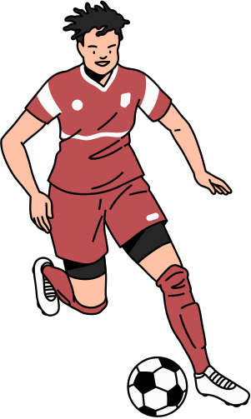



FOOTBALL WORD RACE
Day 2
The Global Game that Unites the World
MATERIALS
TEAMS
  A deck of football-themed cards
  Timer (3 minutes)
  Score sheet
Groups of 3-4 students
  One student = Clue Giver
  Other students = Guessers
  A spy from an opponent team
SCORING
EXTRA BONUS
  1 point = guessed word
  Bonus point if guessed in under 20 seconds.
  Team with most points wins.
  Golden Goal!
The next correct answer is worth 3 points.
  Steal!
Spy may guess for his team once in a round.
RULES
  NO French is allowed
  Team members take turn to give clues
  The clue giver cannot say the word or any word of the same word family, cannot spell the word.
  The spy changes after each round. He checks if everyone respects the rules and collects the points.
Round 1: Describe It
  The clue giver can describe the word, give examples, say what it looks like, what it is used for...
  The guessers cannot ask any questions.
Round 2: One Sentence Only
  The clue giver may say only ONE sentence.
  Each guesser can ask only ONE yes-no question.
  The guessers make 3 propositions.
Round 3: Charades
  The clue giver : No speaking.
Only mime.
  The guessers make propositions.
SAINT-FLEUR Jéda - Lycée JARDIN D'ESSAI - Région Académique de Guadeloupe

Slide 5

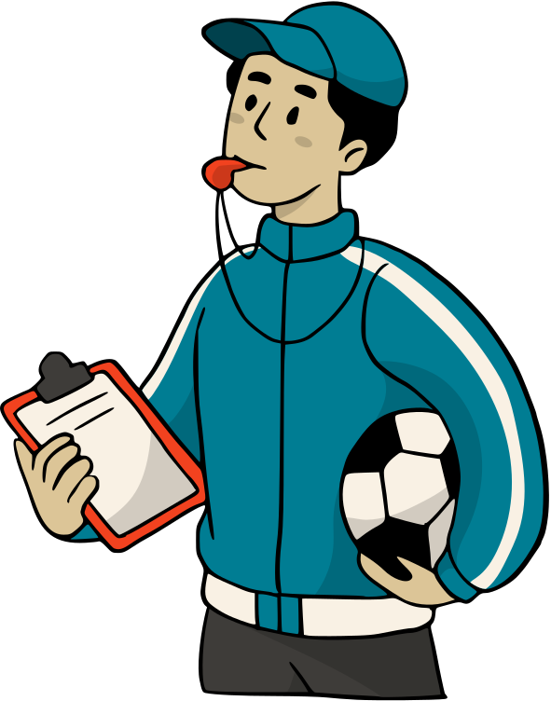
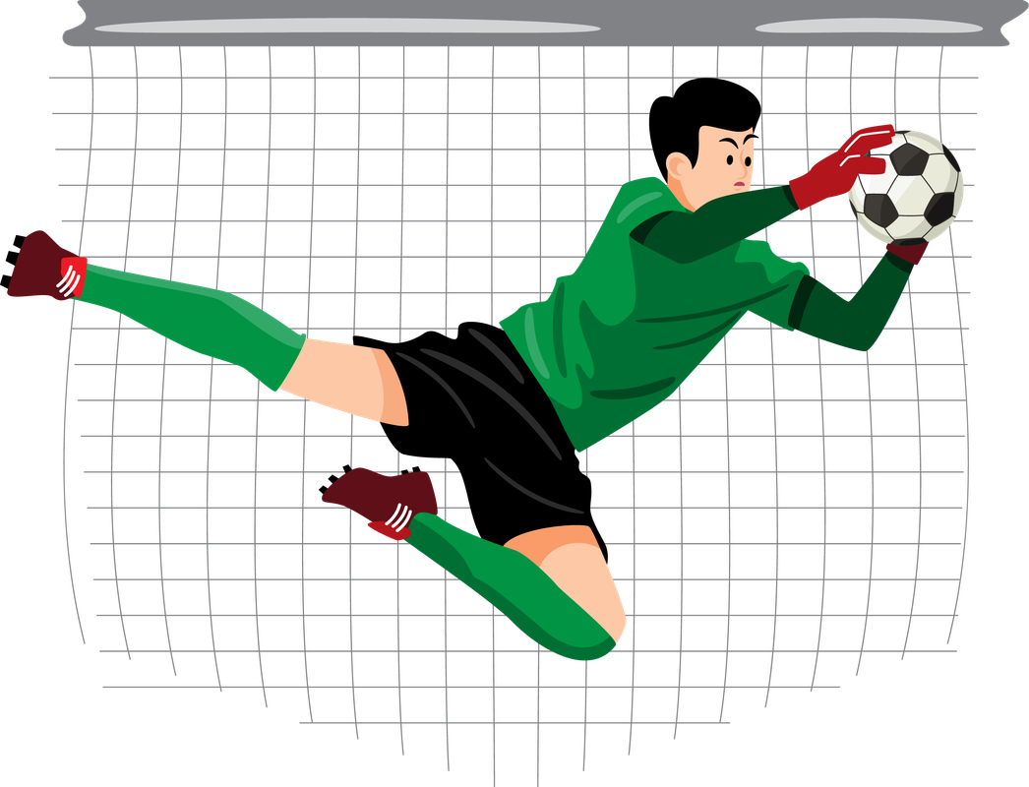

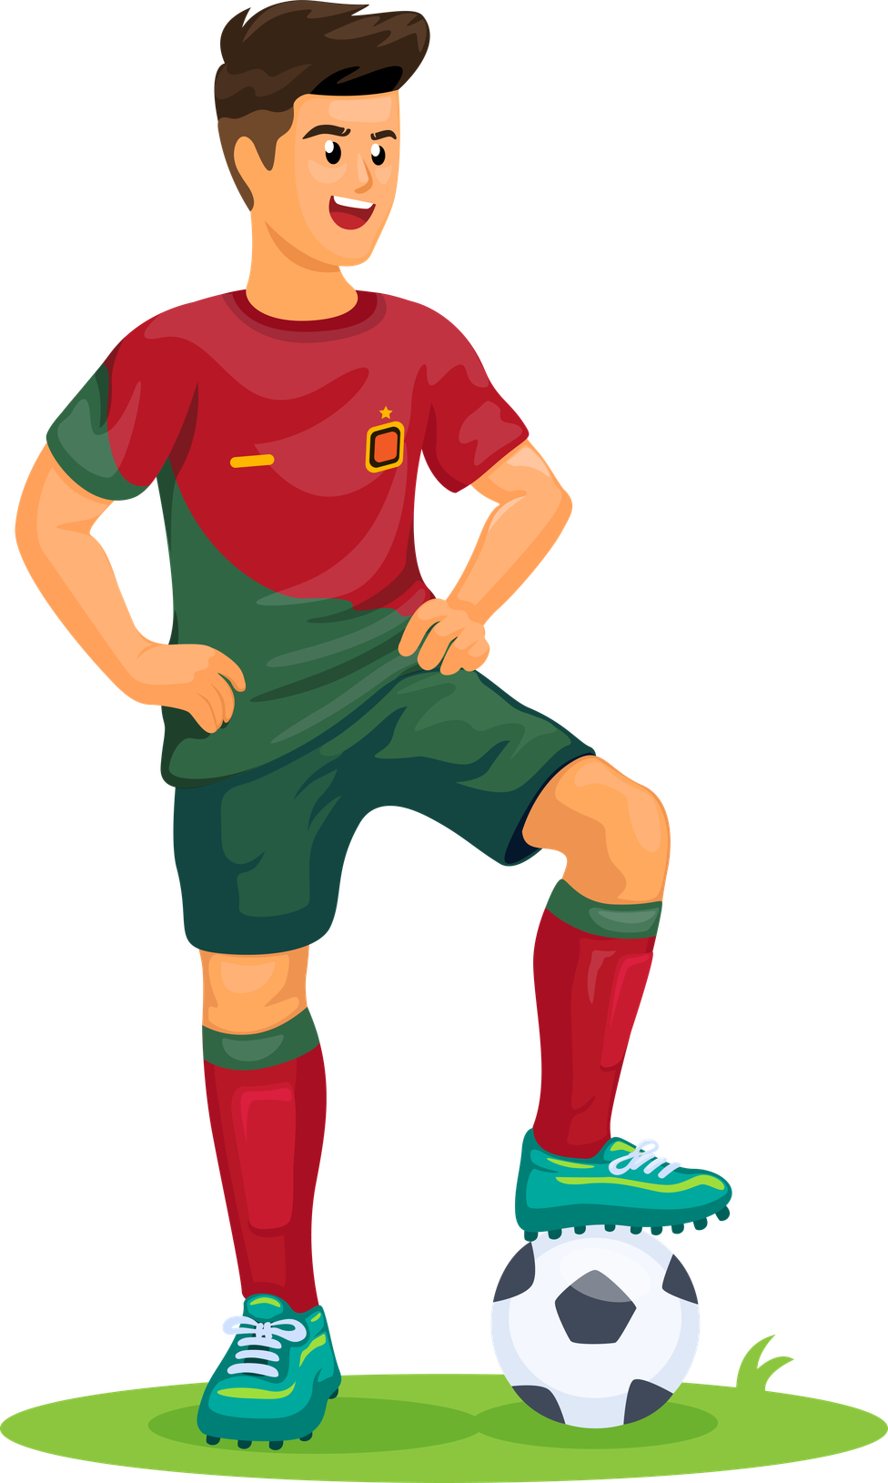

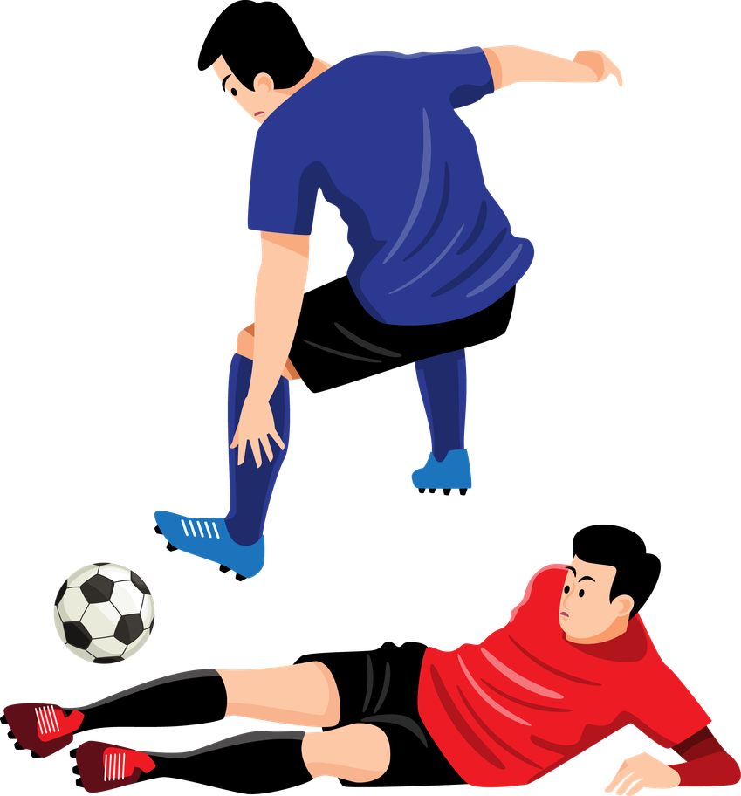
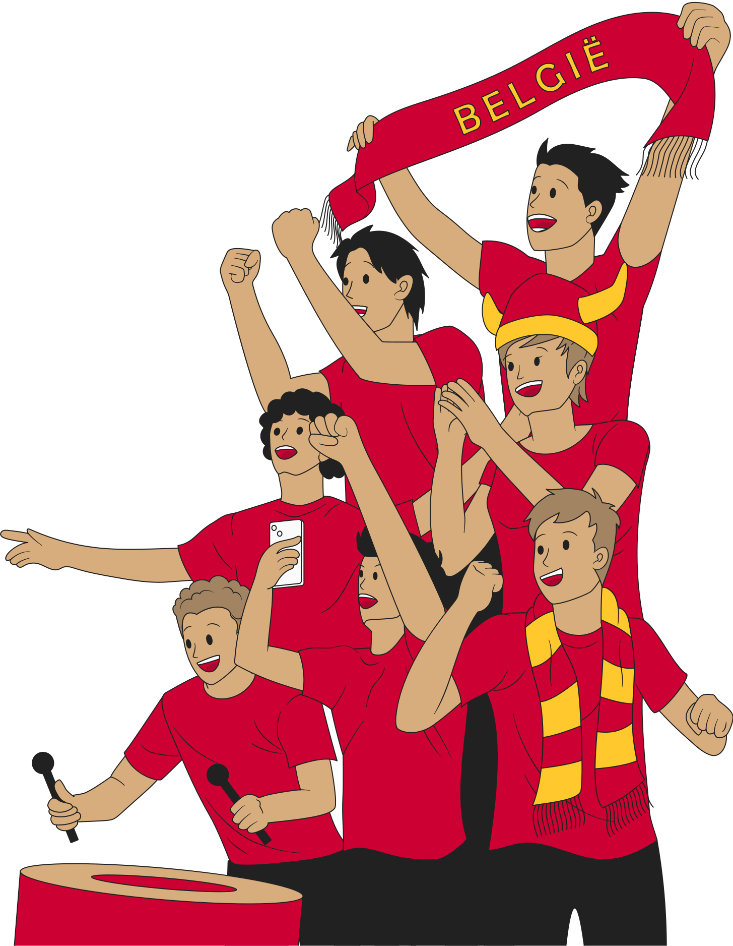

PERSON
PERSON
PERSON
PERSON
GOALKEEPER
COMMENTATOR
REFEREE
COACH
PERSON
PERSON
PERSON
PERSON
CAPTAIN
STRIKER
DEFENDER
SUPPORTER

Slide 6
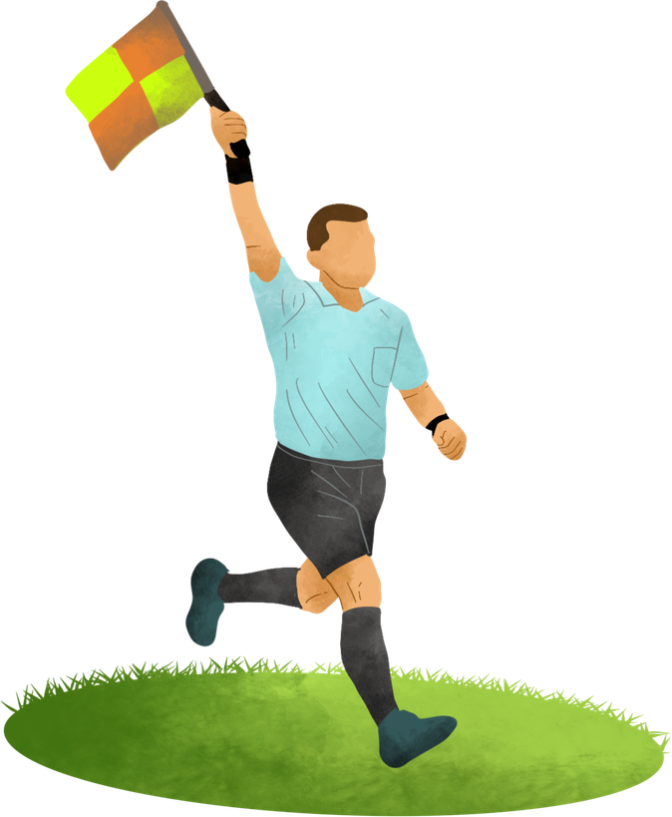
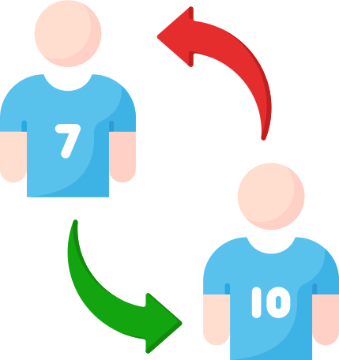
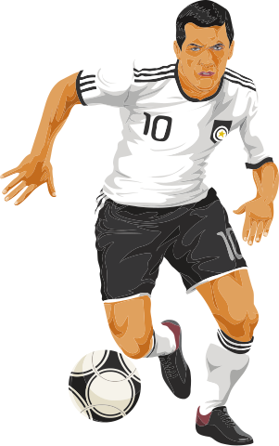
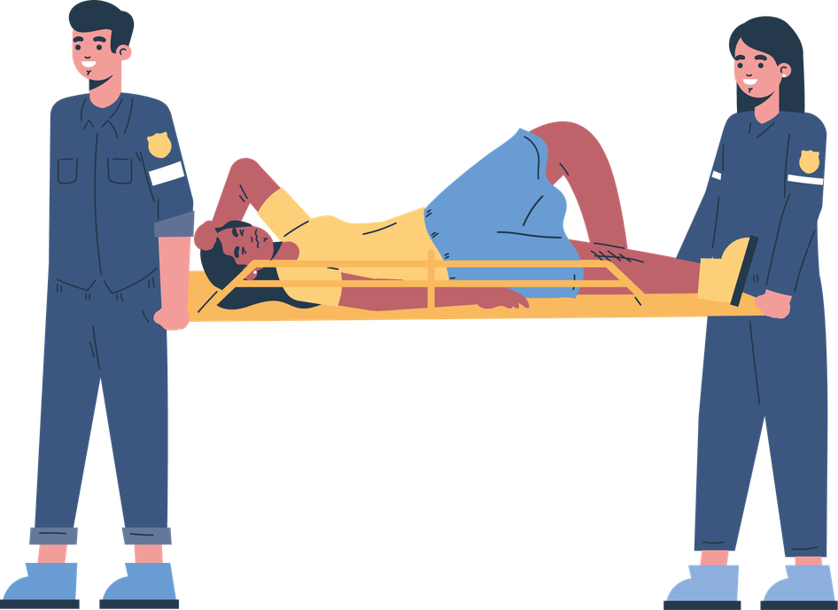
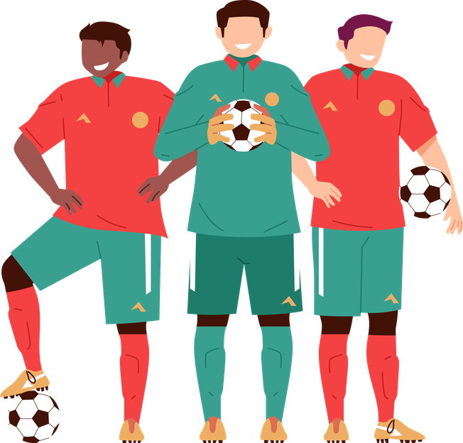

PERSON
PERSON
PERSON
PERSON
LINESMAN
SUBSTITUTE
MIDFIELDER
PARAMEDICS
PERSON
PERSON
PERSON
PERSON
PLAYERS
JOURNALIST
----------
----------

Slide 7

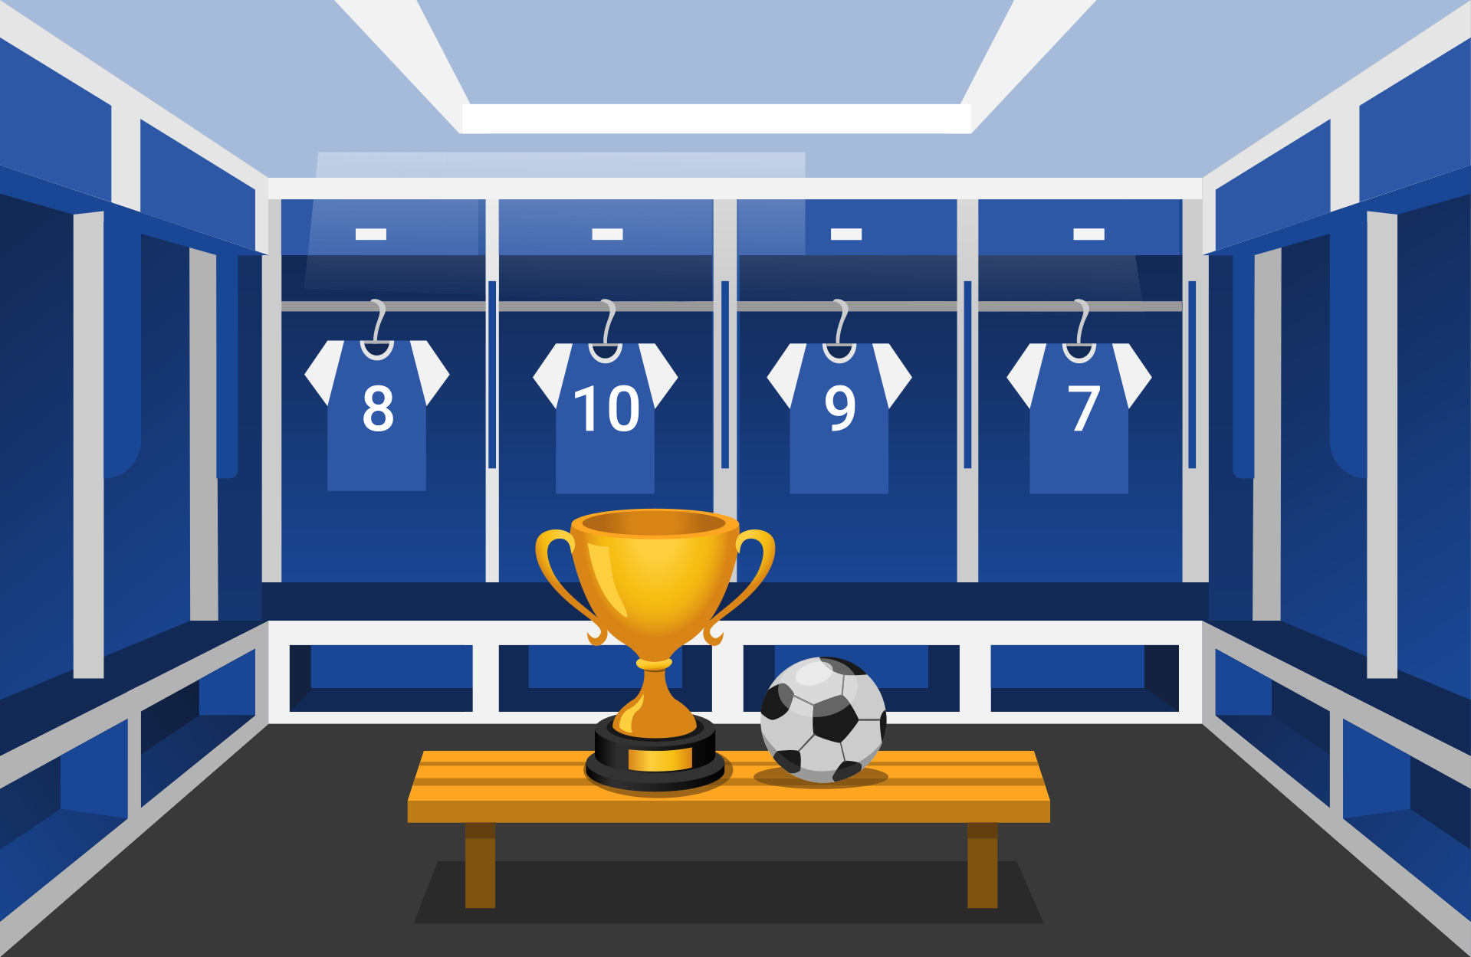
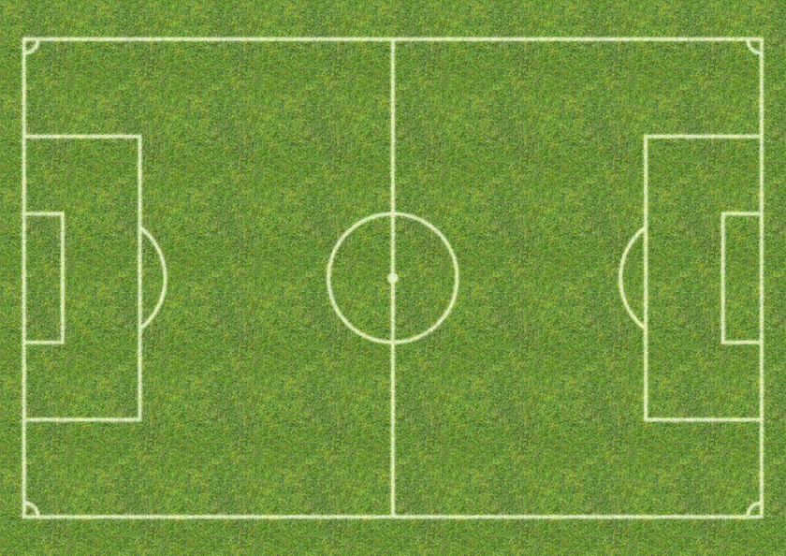
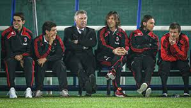
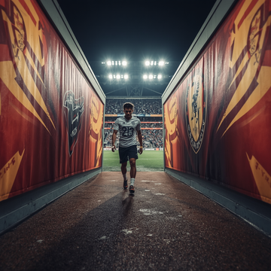



PLACE
PLACE
PLACE
PLACE
STADIUM
LOCKER ROOM
BENCH
PITCH
PLACE
PLACE
PLACE
PLACE
TUNNEL
VANCOUVER
GUADALAJARA
PENALTY AREA

Slide 8

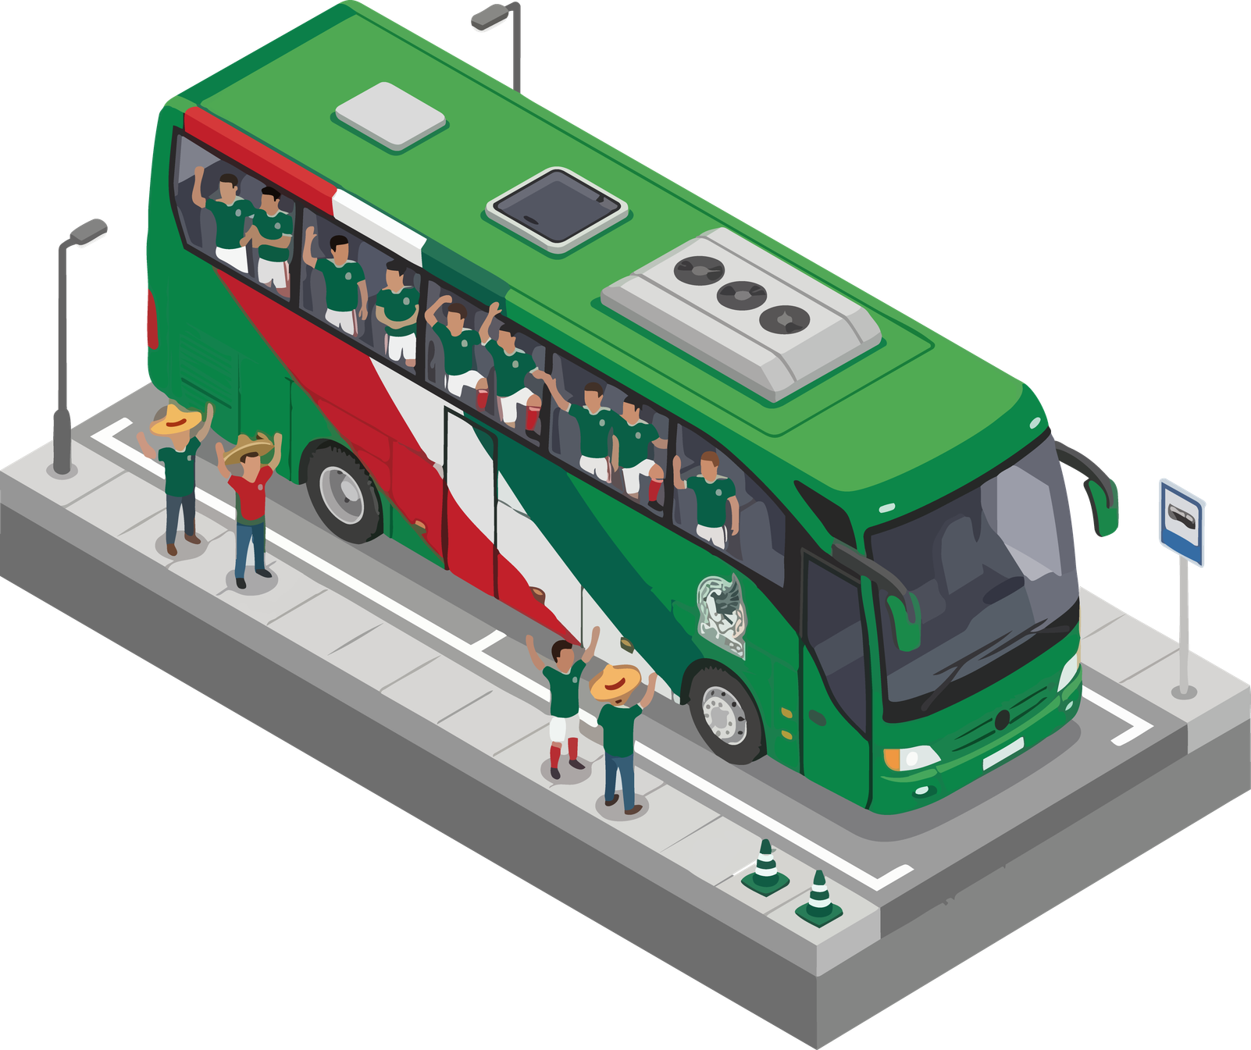
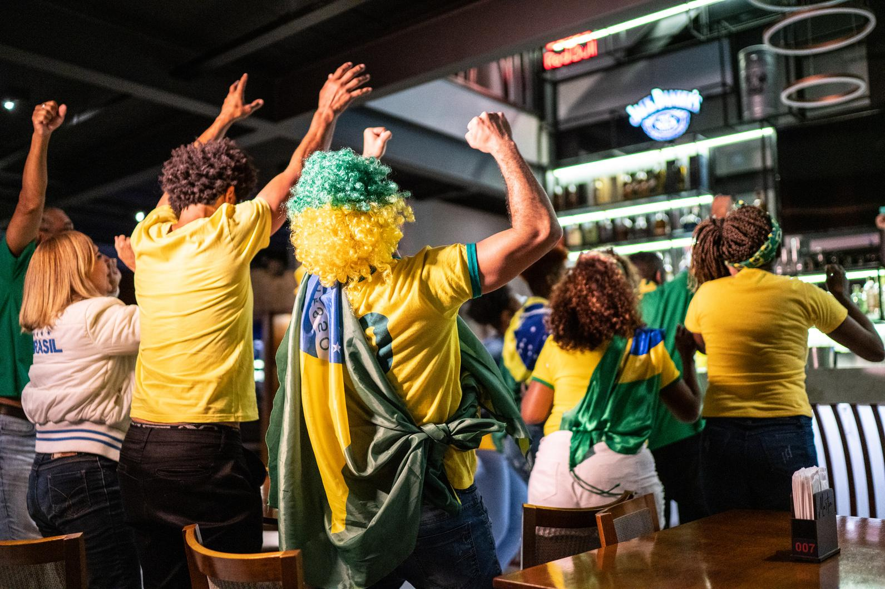
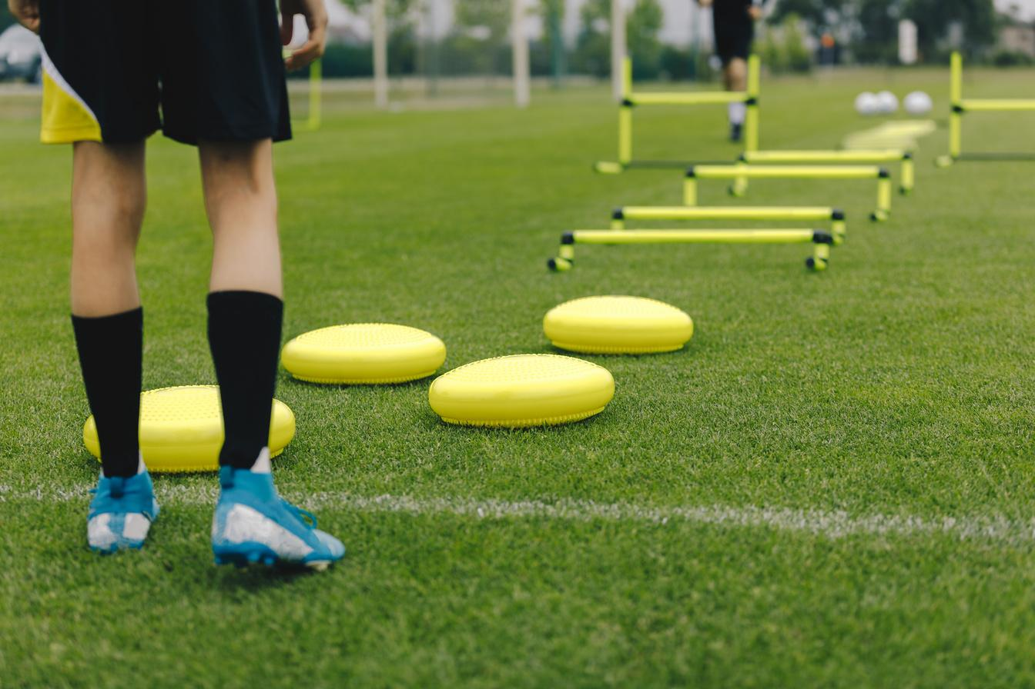
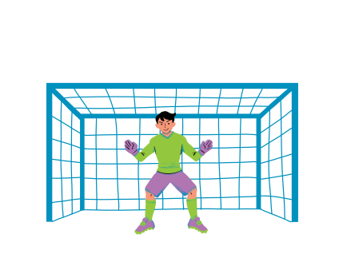
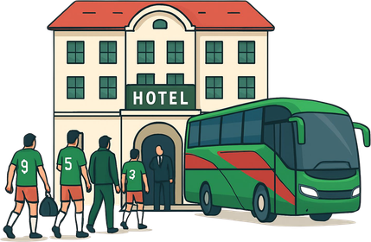
PLACE
PLACE
PLACE
PLACE
PRESS ROOM
FAN ZONE
TRAINING GROUND
TEAM BUS
PLACE
PLACE
PLACE
PLACE
TEAM HOTEL
GOAL
--------
--------

Slide 9




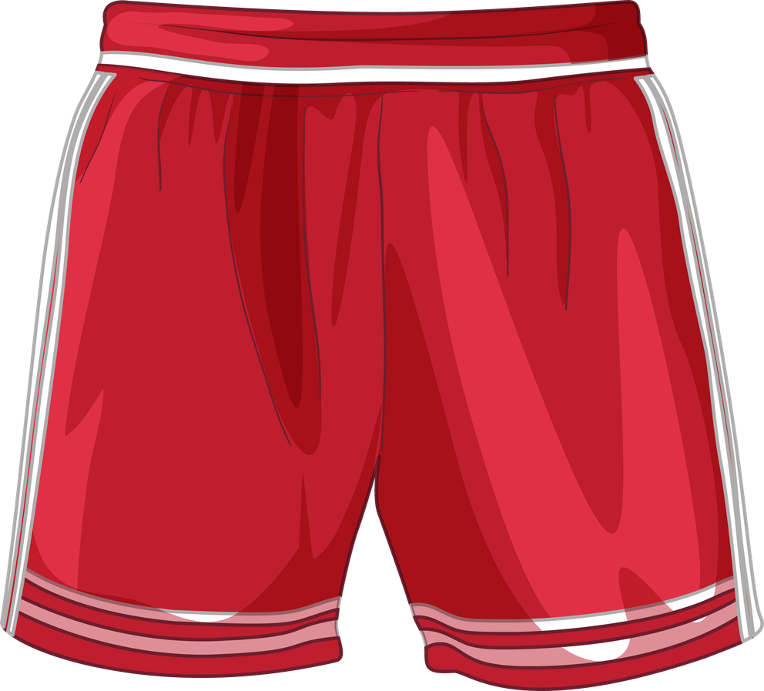
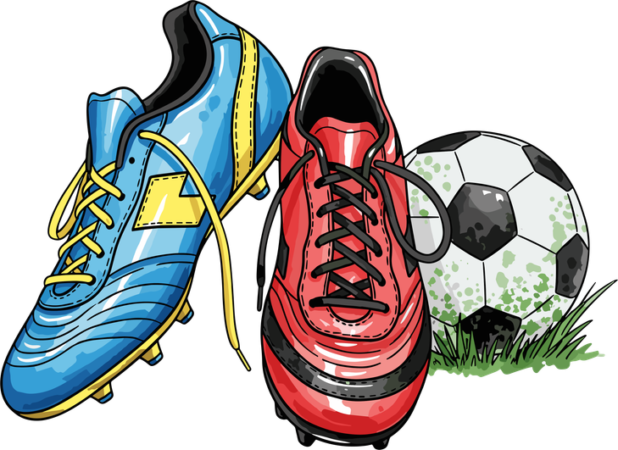


THING
THING
THING
THING
GOAL NET
TROPHY
MEDAL
JERSEY
THING
THING
THING
THING
SHORTS
GLOVES
FOOTBALL BOOTS
SHIN PADS

Slide 10


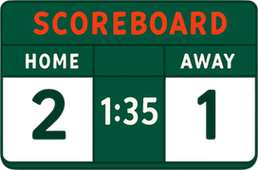



THING
THING
THING
THING
YELLOW CARD
CORNER FLAG
SCOREBOARD
TICKET
THING
THING
THING
THING
VAR
WHISTLE
----------
---------
Video Assistant Referee

Slide 11
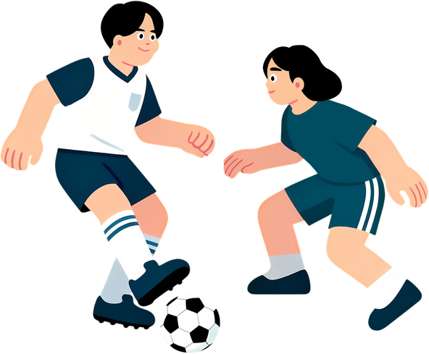
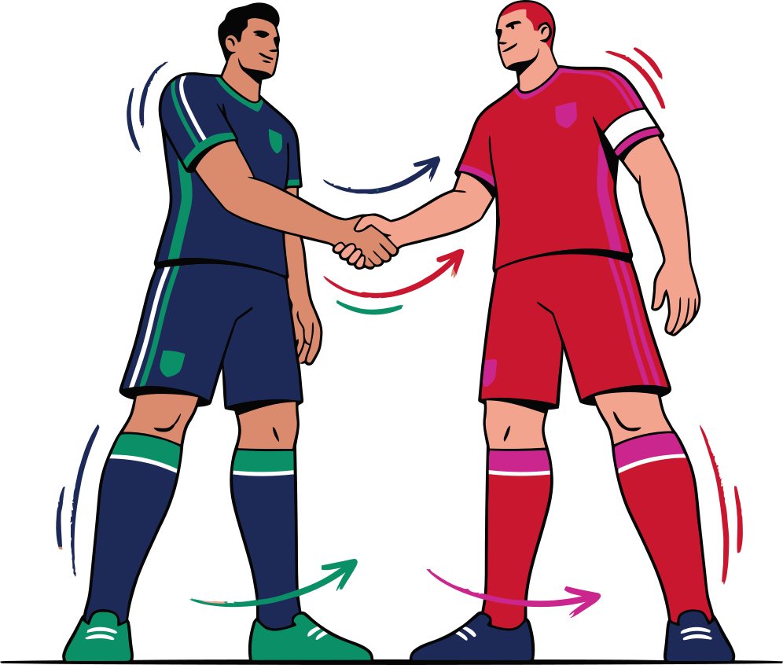
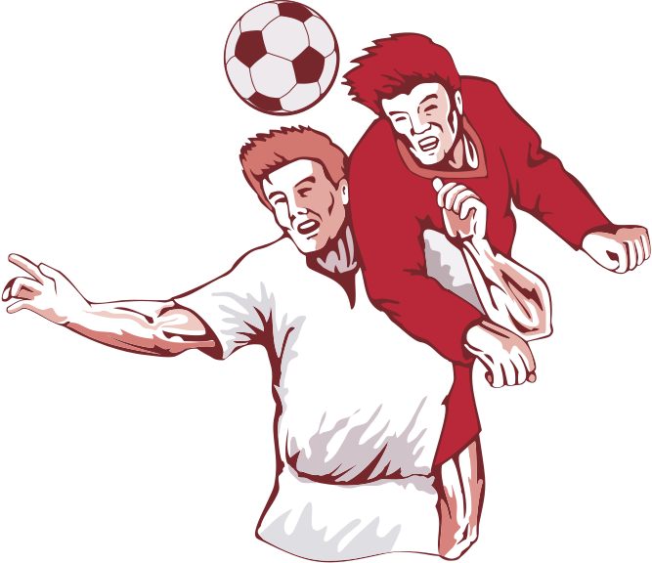
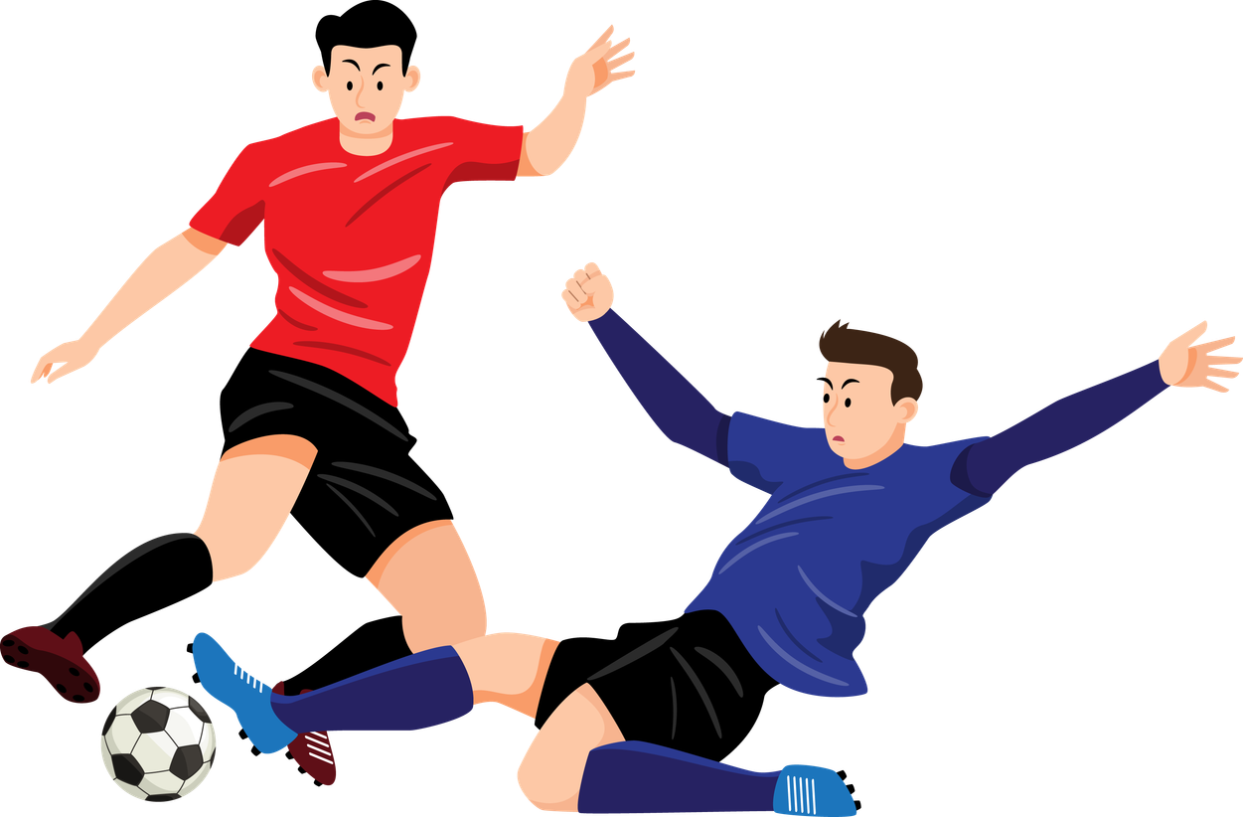
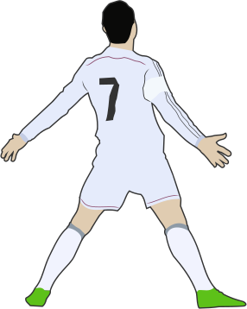

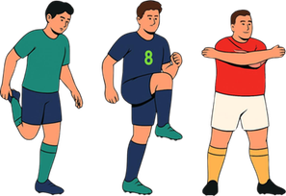
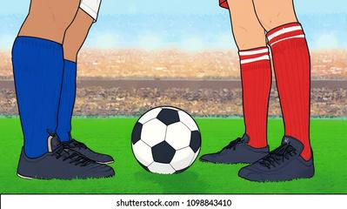
ACTION
ACTION
ACTION
ACTION
DRIBBLE
TACKLE
SHAKE HANDS
HEAD THE BALL
ACTION
ACTION
ACTION
ACTION
CELEBRATE A GOAL
WARM UP
KICK OFF
LIFT THE TROPHY

Slide 12
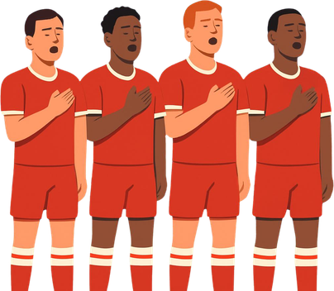
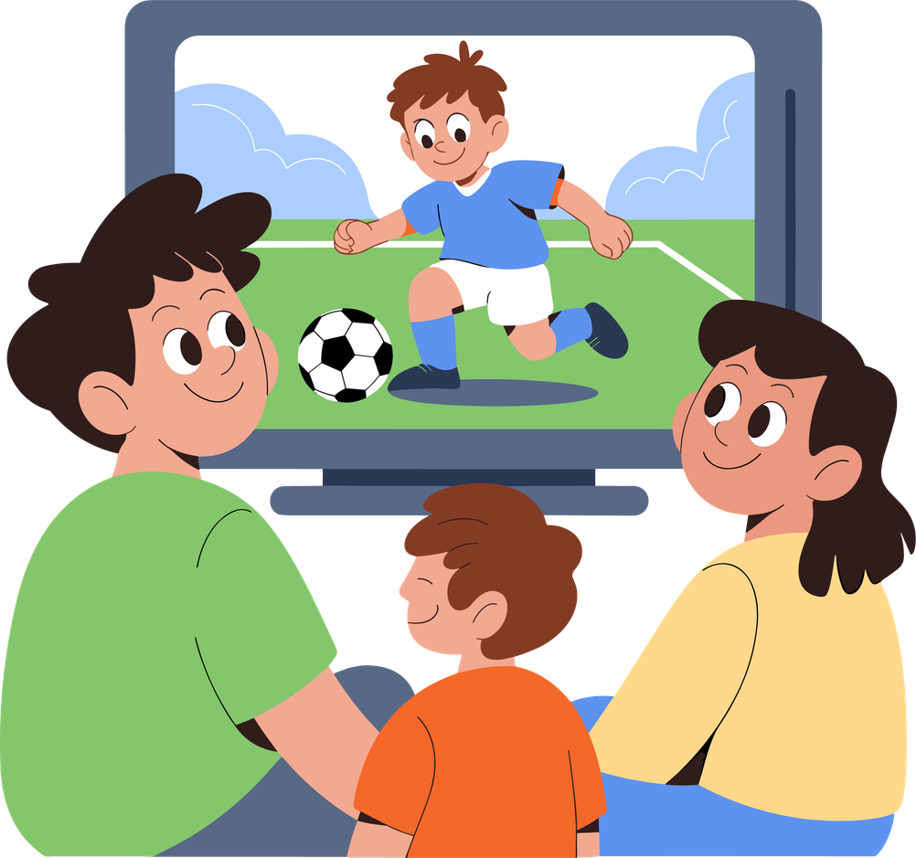



ACTION
ACTION
ACTION
ACTION
SING
THE NATIONAL ANTHEM
SAVE A GOAL
WATCH A MATCH
BLOW THE WHISTLE
ACTION
ACTION
ACTION
ACTION
TAKE A FREE KICK
THROW IN
---------
----------
SAINT-FLEUR Jéda - Lycée JARDIN D'ESSAI - Région Académique de Guadeloupe

Slide 13
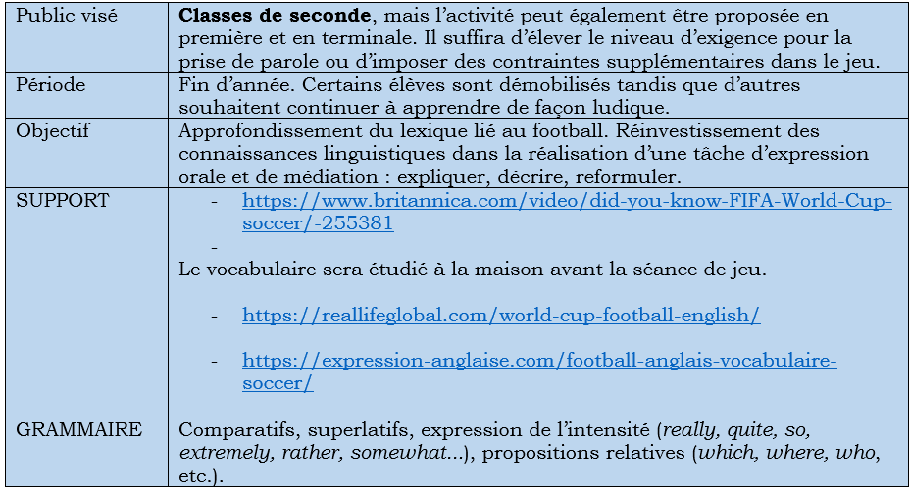
Une fiche d’activités simples et ludiques qui colle à l’actualité : La coupe du monde de football
SAINT-FLEUR Jéda - Lycée JARDIN D'ESSAI - Région Académique de Guadeloupe

