Slide 1



Online Etiquette Quiz
LYDIE PHILBERT –
COLLEGE EDMOND BAMBUCK
ACADÉMIE DE LA GUADELOUPE

Slide 2
Instructions
You will read 15 situations about online behavior.
For each question, choose the best answer ( A,B,C or D).
Your goal is to choose the most respectful, safe and responsible behaviour online.
We will correct and explain each answer together.

Slide 3
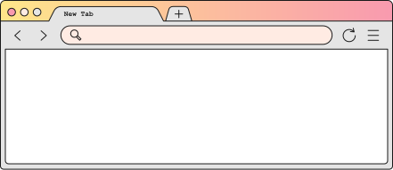
Question 1
Someone sends you a funny picture of a classmate in a group chat. What should you do ?
A. Share it with more friends
B. Save it on your phone
C. Delete it and don’t share it
D. Post it on your story

Slide 4
Answer 1
✅ C. Delete it and don’t share it
Sharing a picture without permission is disrespectful and can hurt the person.

Slide 5
Question 2
Before posting a photo of a friend online, what is the best thing to do?
A. Post it if you like it
B. Ask your friend if it is OK
C. Add a funny comment and post
D. Only ask other friends

Slide 6
Answer 2
✅ B. Ask your friend if it is OK
Always ask for permission before posting someone’s photo.

Slide 7
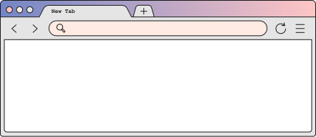
Question 3
You receive a mean comment about a student. What is the best reaction?
A. Laugh with the person who sent it
B. Ignore it and say nothing
C. Tell them it is not kind and they should stop
D. Send it to someone else “to show”
    A. Laugh with the person who sent it
    B. Ignore it and say nothing
    C. Tell them it is not kind and they should stop
    D. Send it to someone else “to show”

Slide 8
Answer 3
✅ C. Tell them it is not kind and they should stop
Speaking up can help stop unkind behaviour.
    A. Laugh with the person who sent it
    B. Ignore it and say nothing
    C. Tell them it is not kind and they should stop
    D. Send it to someone else “to show”

Slide 9
Question 4
Someone creates a fake account to make jokes about a student. What should you do first?
A. Follow the account to see more
B. Report the account
C. Send it to your class group
D. Comment a joke too

Slide 10
Answer 4
✅ B. Report the account
Reporting helps stop harmful content quickly.

Slide 11
Question 5
Your friend is crying because people shared a video of them without permission. What can you say?
A. “It’s not a big deal. Forget it.”
B. “You should send a video of them too.”
C. “I’m sorry this happened. I can help you talk to an adult.”
D. “Just turn off your phone.”

Slide 12
Answer 5
✅ C. “I’m sorry this happened. I can help you talk to an adult.”
Support your friend and help them seek help.

Slide 13
Question 6
You see a sad message from a classmate: “I don’t want to go to school anymore.” What should you do?
A. Send a funny meme
B. Ignore it
C. Ask if they are OK and talk to an adult
D. Share the message so people know

Slide 14
Answer 6
    ✅ C. Ask if they are OK and talk to an adult
    This message is serious. Always inform a trusted adult.

Slide 15
Question 7
Someone writes a rumour about a student on social media. What is a rumour?
A. A funny story
B. A true fact
C. A story you’re not sure is true
D. A school rule

Slide 16
Answer 7
✅ C. A story you’re not sure is true
Rumours can be false and harmful. Don’t spread them.

Slide 17
Question 8
Your classmate asks for your password to “help you”. What do you say?
A. “OK but don’t tell anyone.”
B. “You can change it if you want.”
C. “No, I never share my passwords.”
D. “Only if we exchange passwords.”

Slide 18
Answer 8
✅ C. “No, I never share my passwords.”
Passwords are private. Never share them with anyone.

Slide 19
Question 9
You want to join an online group. They only accept people who send embarrassing photos. What do you do?
A. Send the photo to be part of the group
B. Refuse to send and don’t join
C. Ask others to send photos
D. Create a new group with the same rule

Slide 20
Answer 9
✅ B. Refuse to send and don’t join
A group that pressures you is not a safe group to join.

Slide 21
Question 10
You posted something and a classmate feels hurt. What is the right thing to do?
A. Delete it and apologise
B. Block them
C. Tell them “It was a joke”
D. Ask other friends to defend you

Slide 22
Answer 10
✅ A. Delete it and apologise
Respect others’ feelings. Say sorry and remove the post.

Slide 23
Question 11
You see a mean comment about someone. What is the best role to be?
A. Bystander (just watch)
B. Bully (join in)
C. Upstander (help and support)
D. Joker (make fun of everyone)

Slide 24
Answer 11
✅ C. Upstander (help and support)
An upstander helps stop bullying and supports others.

Slide 25
Question 12
A friend asks you to forward a screenshot of a private conversation. What do you do?
A. Forward it to 3 friends only
B. Forward it but remove the name
C. Say “No, it is private”
D. Post it, but only for 1 hour

Slide 26
Answer 12
✅ C. Say “No, it is private”
Private conversations must stay private.

Slide 27
Question 13
Someone writes you a message saying “You’re stupid”. What should you do?
A. Reply with a worse insult
B. Tell an adult and block them
C. Post the message online
D. Send it to all your friends

Slide 28
Answer 13
✅ B. Tell an adult and block them
Protect yourself. Don’t reply with insults.

Slide 29
Question 14
You want to share a photo of a group of students. What is the safest option?
A. Post it publicly
B. Send it to a private group with permission
C. Post it with funny stickers
D. Tag everyone without asking

Slide 30
Answer 14
    ✅ B. Send it to a private group with permission
    Always ask before sharing group photos.

Slide 31
Question 15
You see a video of someone falling in the playground. Everyone is sharing it.
What is the best choice?
A. Share it with a funny comment
B. Save it for later
C. Do not share it and tell others to stop
D. Make a remix video

Slide 32
Answer 15
✅ C. Do not share it and tell others to stop
Sharing embarrassing videos can hurt people. Stop the chain.

Slide 33

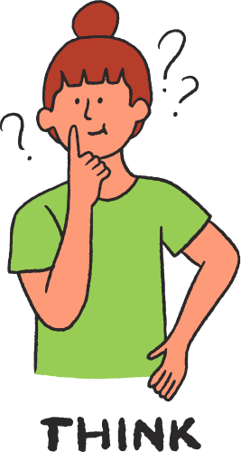


Be kind online
Protect privacy
Think before you share

