Slide 1
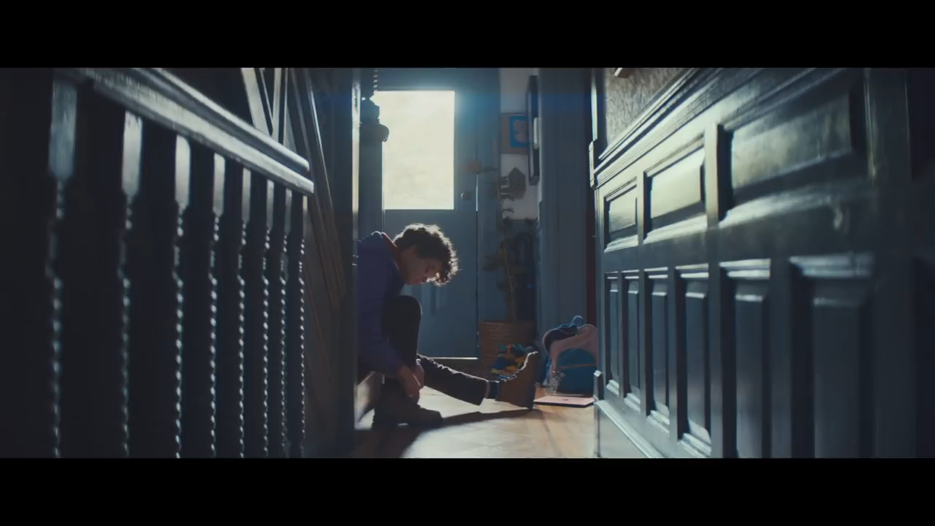

Slide 2
Use the methodology to understand the video
What sort/ kind/ type of document is it ?
What is it about ? Give the key words.
Who is/ are the main character(s) ? Age?
Where does the scene take place ? ( places)
Réponse attendue : It’s an ad = advertisement.
Réponse attendue : A girl, bike, Ipad , computer, drawing, sending , taking pictures….
Vocabulary :
An ad = an advertisement = une publicité
An ad ≠ to add ( don’t confuse ! )
To add comments
-To put special effects
To draw
To send
-to bring
Old fashioned = fashionable
Réponse attendue :
Maybe she’s eleven, she’s a girl , she’s a kid/ child, maybe the woman is her mum.
Réponse attendue :
at the baker’s, in the garden, in the street, in the bus.
LGT Sonny RUPAIRE
by Miss MAUREAU & Mr MANIGA

Slide 3
Use the methodology to understand the video
when did it happen?
What are the consequences? What’s the woman’s and the girl’s questions in the last part of the video? Compare the Ipad to a PC.
Réponse attendue : All day long, in the morning, in the afternoon, after school…
Vocabulary :
An ad = an advertisement = une publicité
An ad ≠ to add ( don’t confuse ! )
To add comments
-To put special effects
To draw
To send
-to bring
Old fashioned = fashionable
Happen = occur
Réponse attendue : What are you doing on your computer ? What’s a computer, more than , less than. Funnier.
LGT Sonny RUPAIRE
by Miss MAUREAU & Mr MANIGA

Slide 4
Use the methodology to understand the video
Amélioration apportée avant trace écrite finale
Trace écrite: productions et énoncés des élèves
Amorce élève
I can see /notice a kid he may be 11 or 13 years old
I saw the kid riding his bike, taking pictures, adding/putting effects , playing/ drawing with her IPAD.
The child is the main character.
I can see she‘s riding her bike.
Thanks to/ due to her ipad, she can use special effects into her pictures.
She’s having fun/ enjoying herself
The Ipad is more fashionable than the PC, which is
LGT Sonny RUPAIRE
by Miss MAUREAU & Mr MANIGA

Slide 5
What do you think about this ad?
Notre but est de donner de l’importance à chaque élève et d’inscrire au tableau son prénom à l’intérieur de son énoncé. Exemple :
Nathan said that the children were chatting and having a face time via the Ipad
What were the children doing?
What did you love doing when you were a child ?
Réponse attendue : All day long, in the morning, in the afternoon, after school…
LGT Sonny RUPAIRE
by Miss MAUREAU & Mr MANIGA

Slide 6
What do you think about this ad?
Vocabulary :
An ad = an advertisement = une publicité
An ad ≠ to add ( don’t confuse ! )
To add comments
-To put special effects
To draw
To send
-to bring
Old fashioned = fashionable
What are the children doing?
      What dId you love doing when you were a child ?
LGT Sonny RUPAIRE
by Miss MAUREAU & Mr MANIGA
Notes:
I can see a kid he may be 11 or 13 years old
I saw the kid riding his bike, taking pictures, adding/putting effects , playing/ drawing with his IPAD
The child is the main character
I can see he ‘s riding his bike.
To add comments
Thanks to her ipad, she can use special effects into her pictures.
An ad = une publicité
Advertisement/ advertising
To draw - to send pictures – to take photos – to have a key board
We can bring it very easily
Old fashioned --→ génération gap
compagnies
Os : windows, IOS, Captain, Android
Mark: SONY , APPLE, ACER ,LG etc
to read / writte datas
What do you love to do when you’re a child ?
1 or 0 binary information complex information

