Slide 1
Worksheet : Food idioms
Learn the following words and their meaning

Slide 2
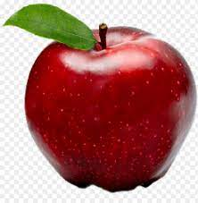
An Apple

Slide 3
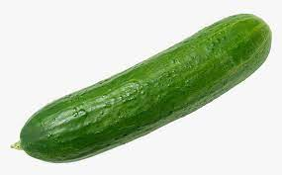
A cucumber

Slide 4
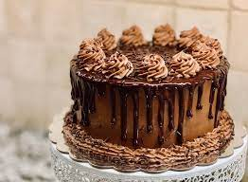
A cake

Slide 5
Cherries

Slide 6
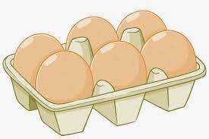
Eggs

Slide 7
Fish

Slide 8
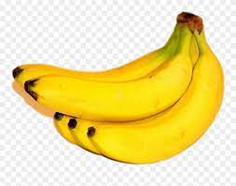
Bananas

Slide 9
Pear

Slide 10
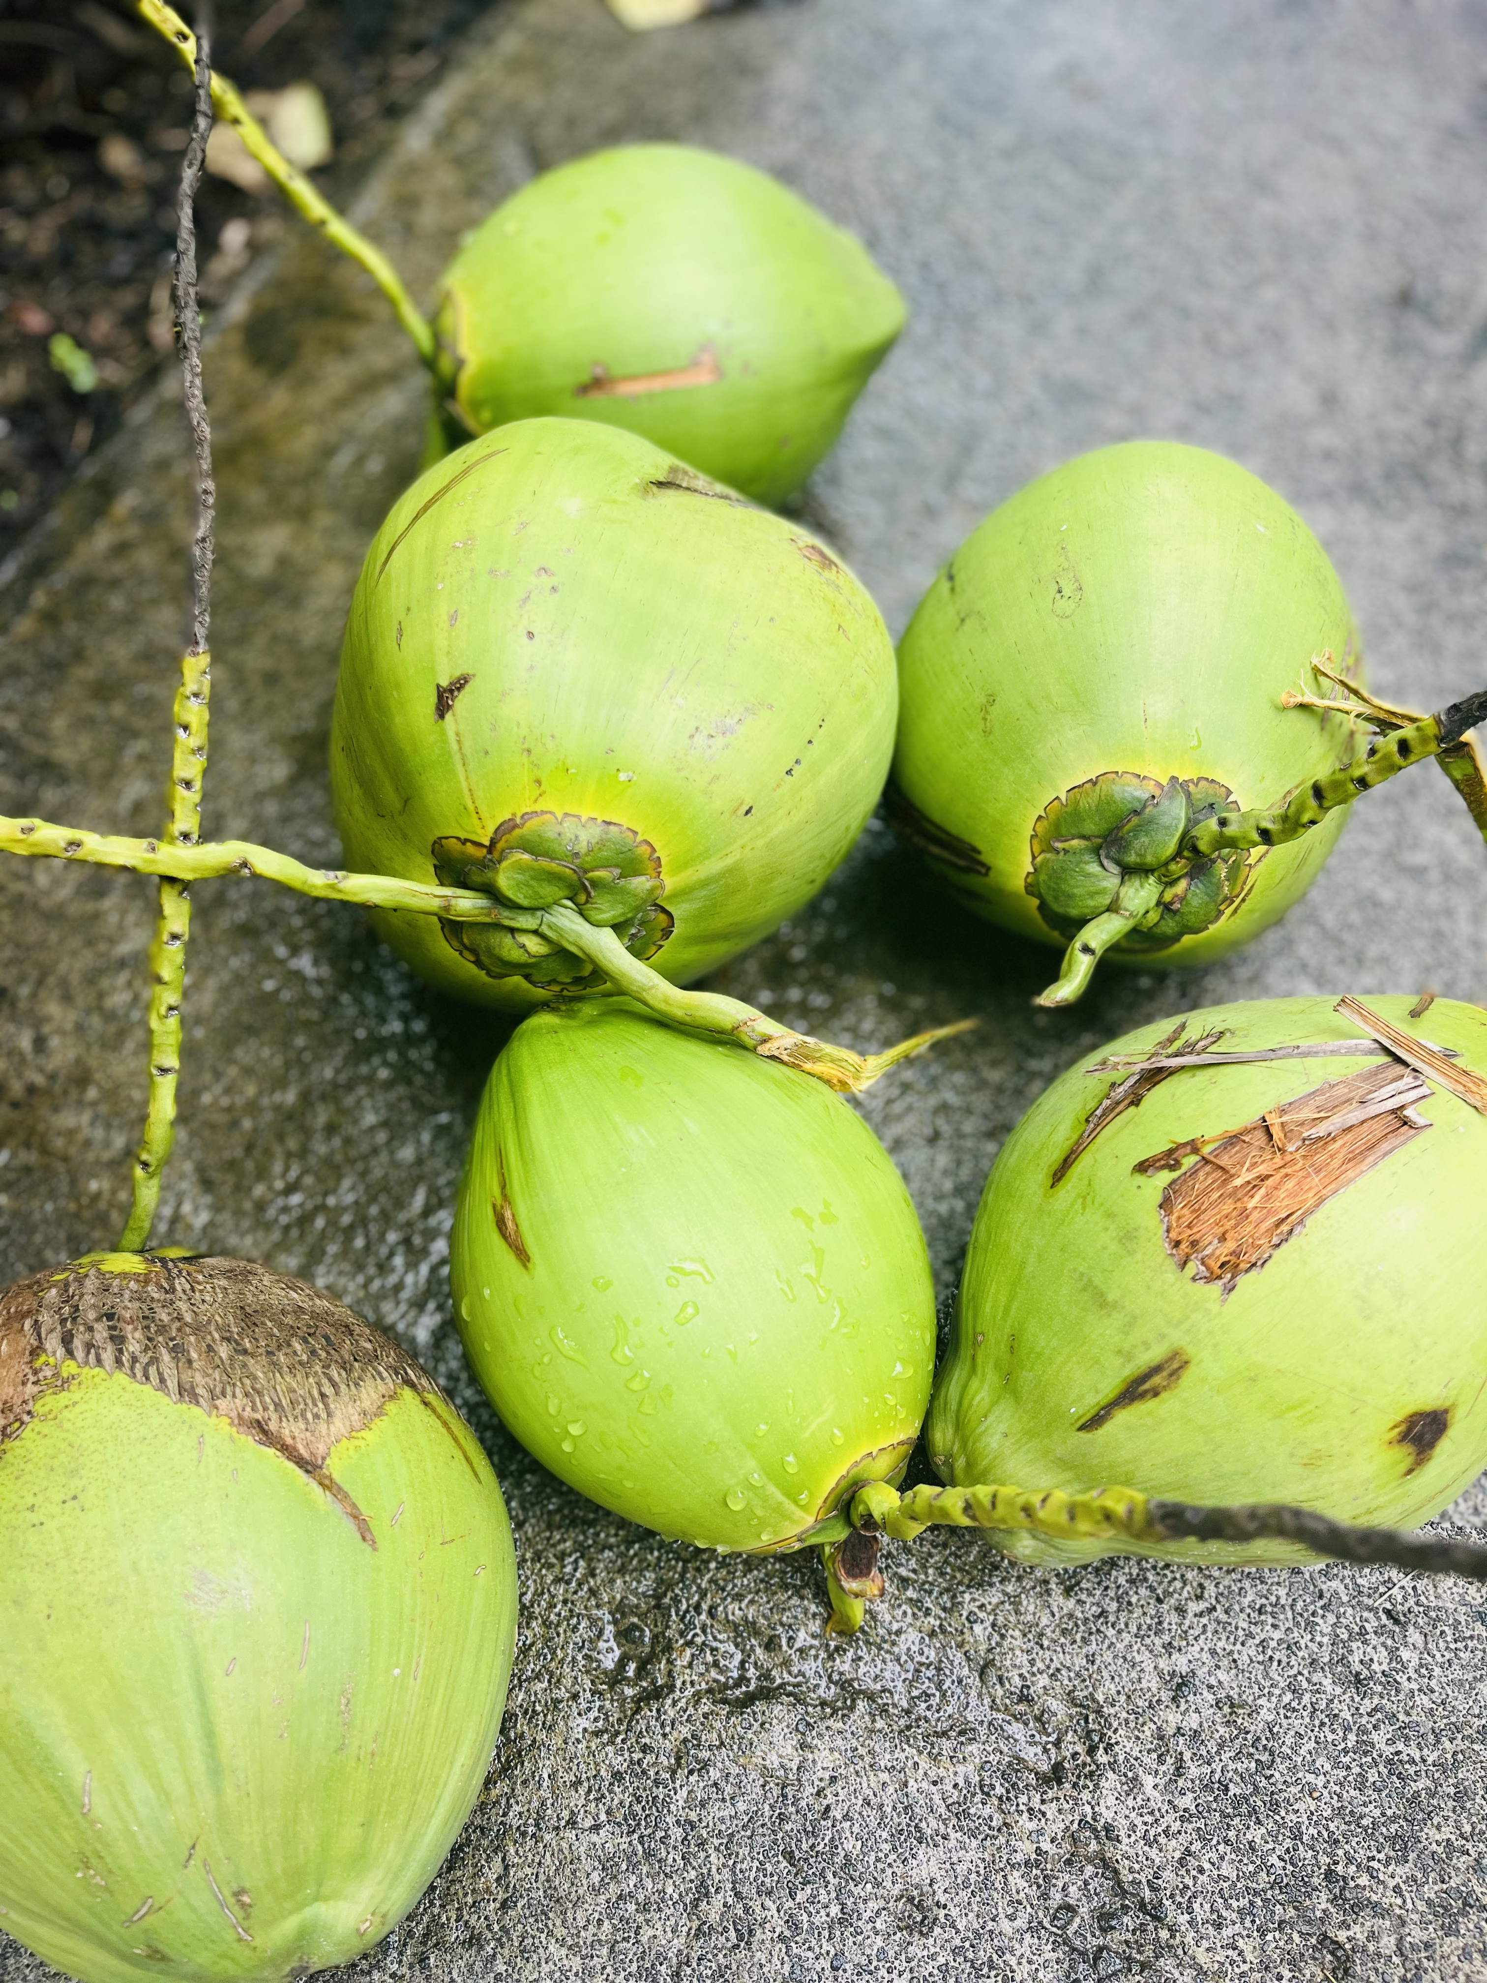
Coconuts

Slide 11
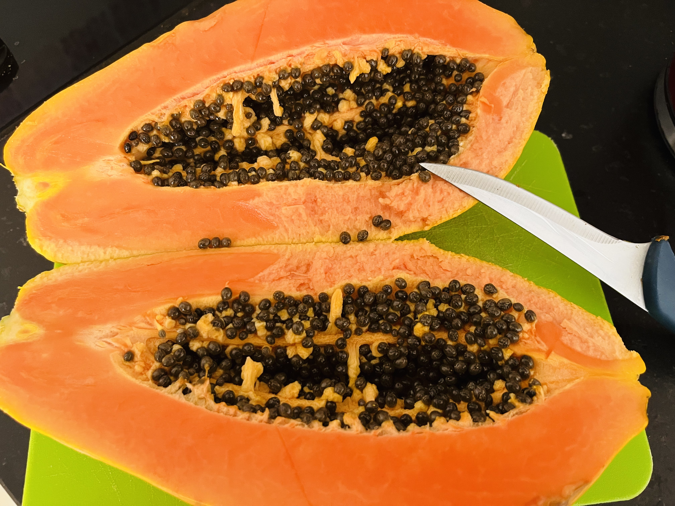
Papaya

Slide 12
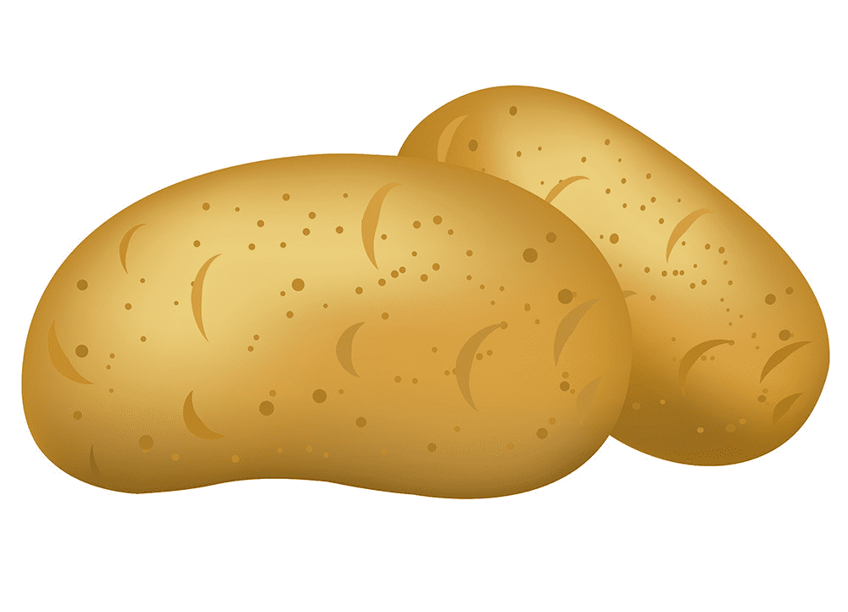
Potatoes

Slide 13
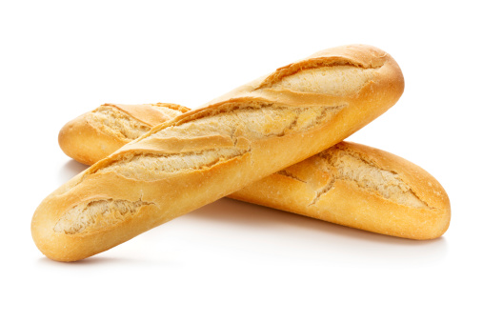
Bread

Slide 14
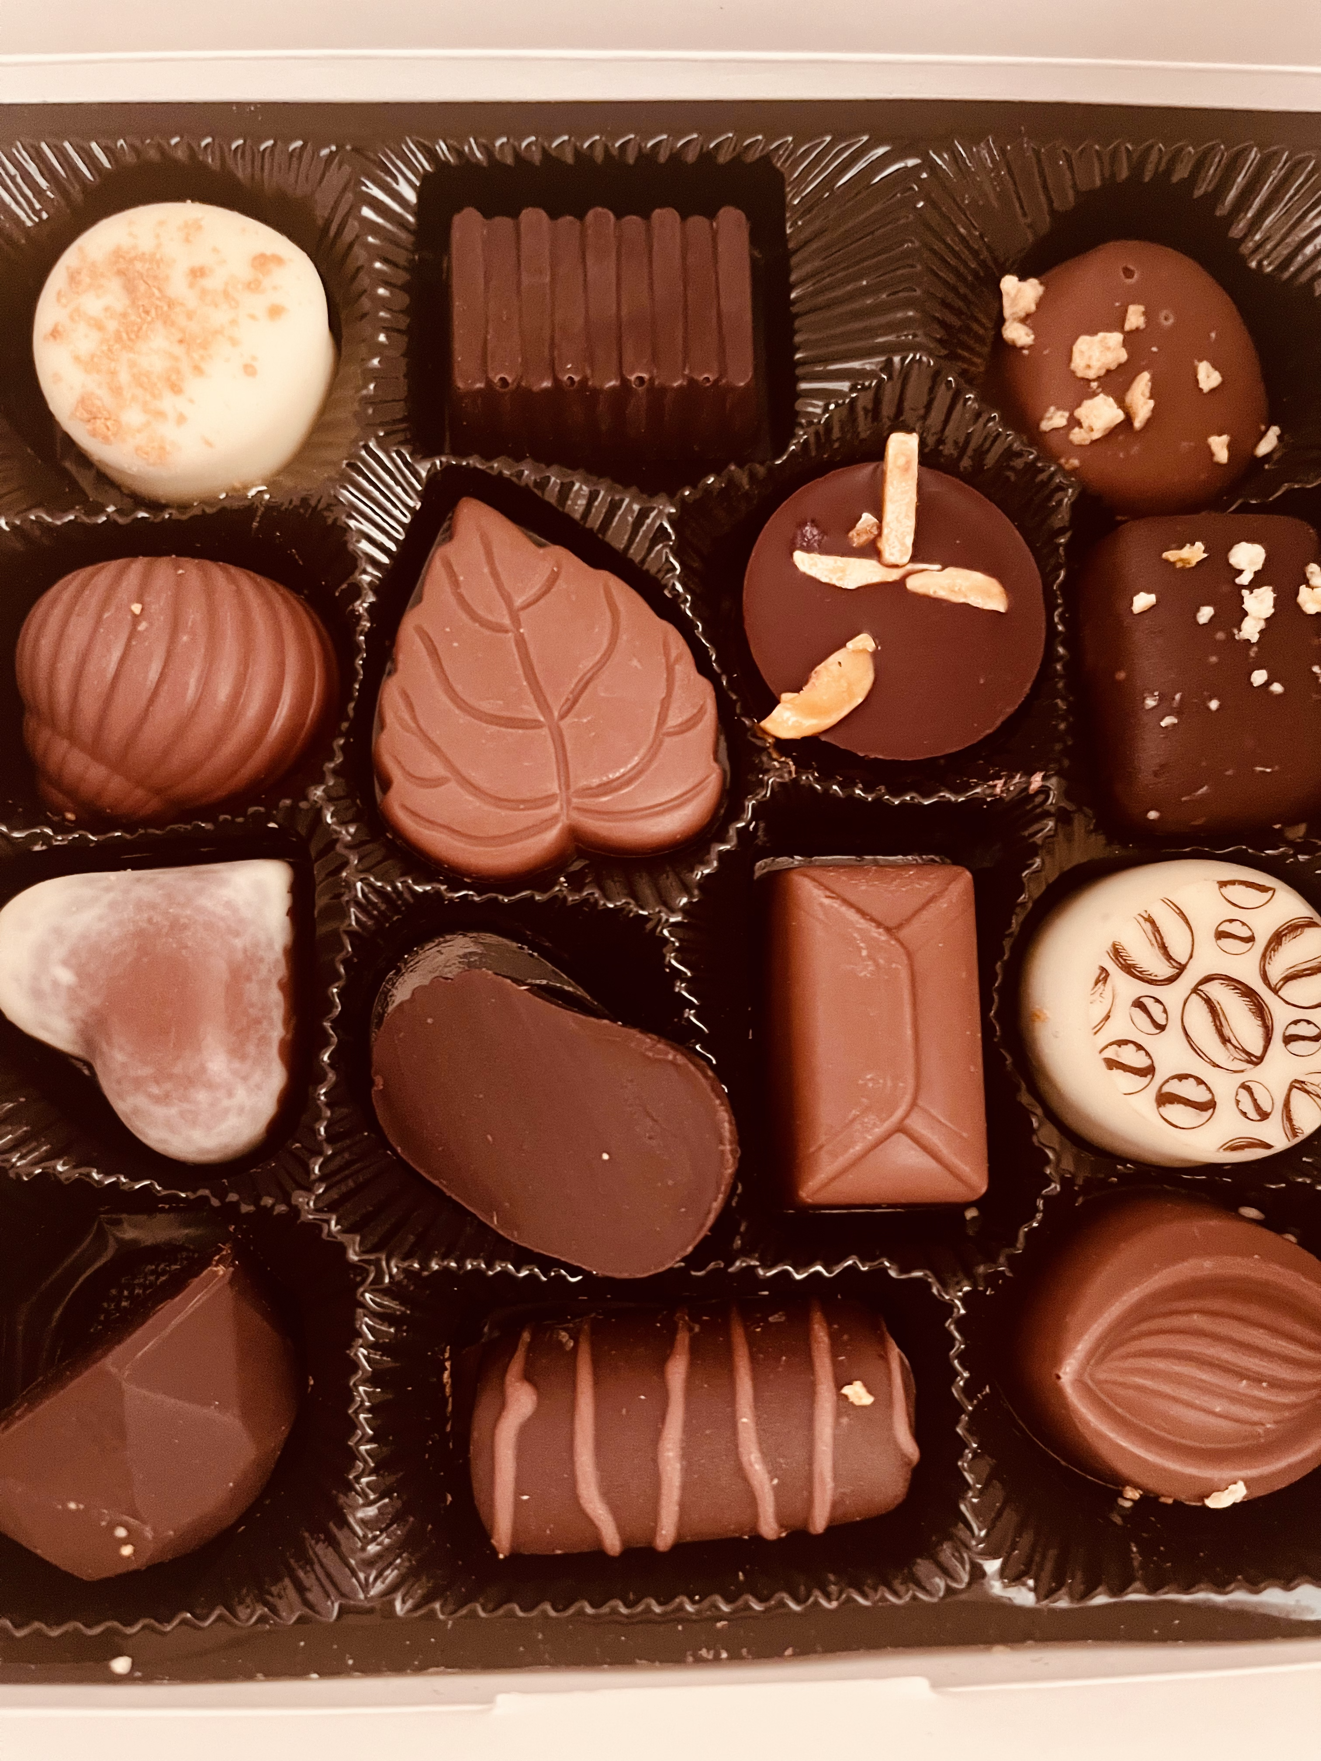
Chocolate

Slide 15
How many words do you remember ? Let’s see …

Slide 16
B……

Slide 17
….d

Slide 18
.a..

Slide 19
An .pp..

Slide 20
C…….

Slide 21
….

Slide 22
P…….

Slide 23
E…

Slide 24
C……..

Slide 25
.o.o….

Slide 26
P…..

Slide 27
A c…….

