Slide 1
1st Annual Collège Carnot
8/4/2022

Slide 2
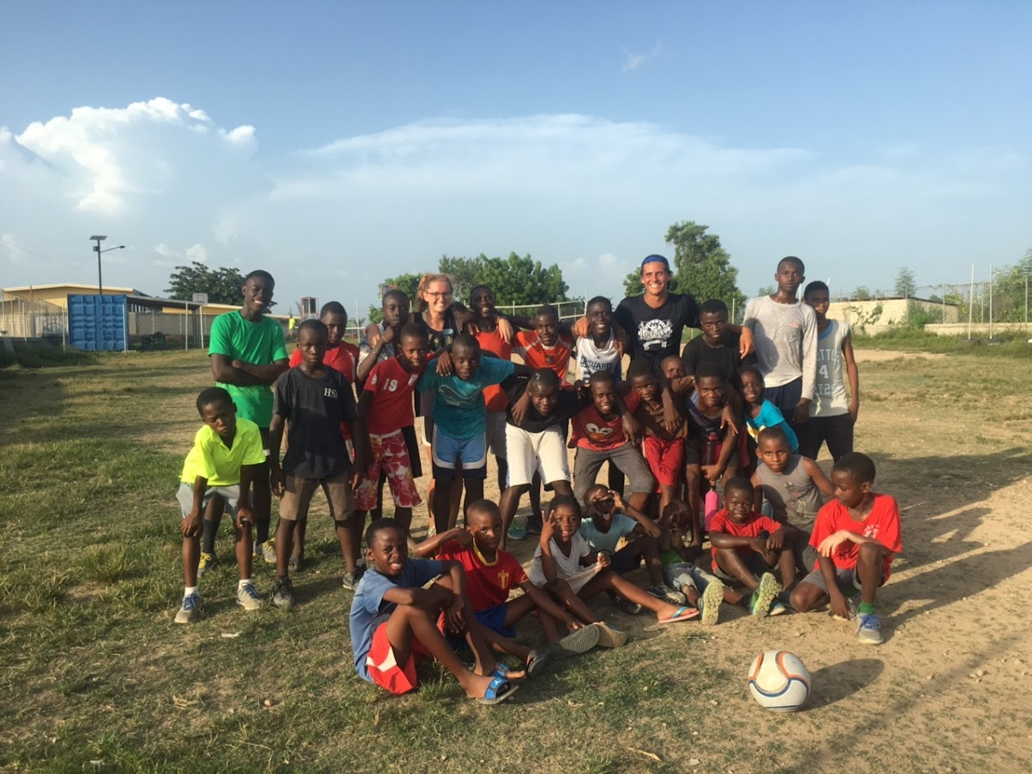
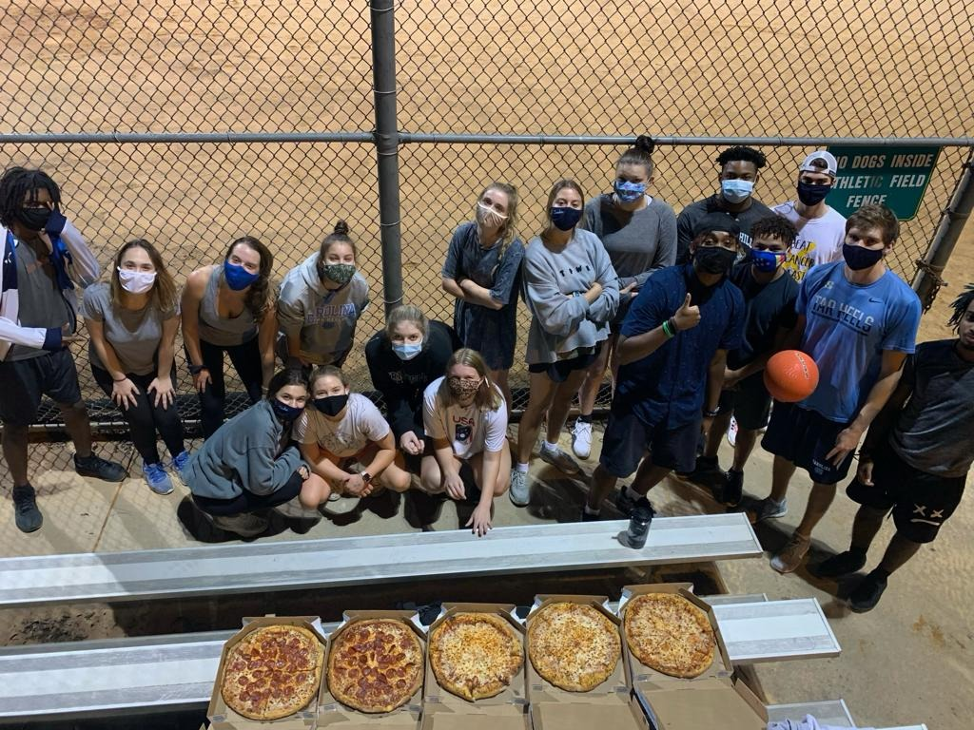
What is Field Day?
A field day is a fun day to celebrate the end of the school year, show some class pride and be active.
Classes compete in several games for a prize https://m.facebook.com/watch/?v=3977229365686525&_rdr
Field Day 2017 – Respire, Haiti
Field Day 2020 – Chapel Hill, NC

Slide 3
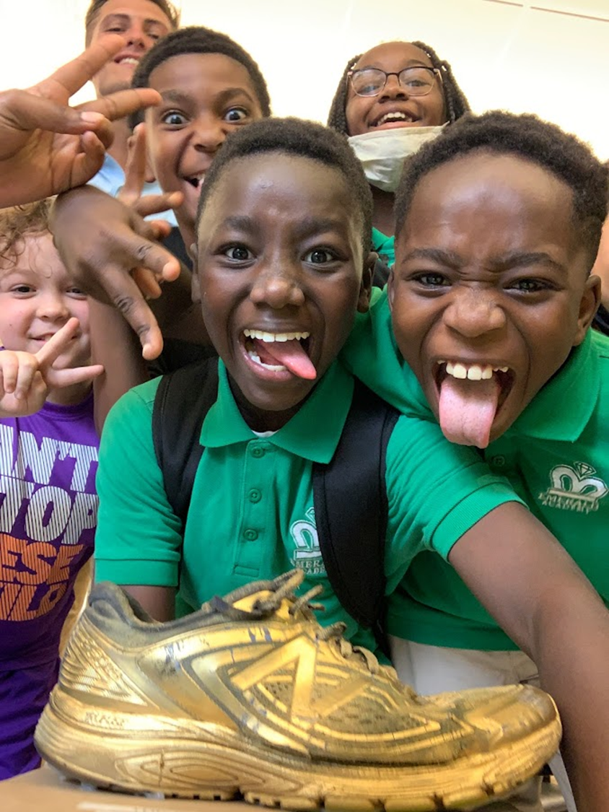
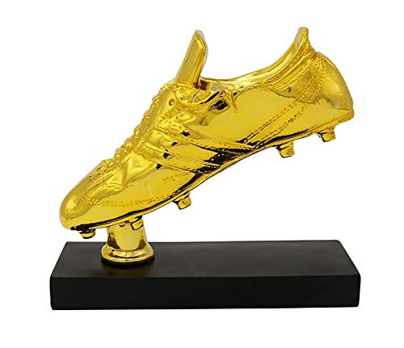
First Place Winners
Teams compete for the Golden Boot, the prestigious first place prize.
First Place Field Day 2021

Slide 4
Teams
University of North Carolina
University of Alabama

Slide 5
LSU
University of Tennessee

Slide 6
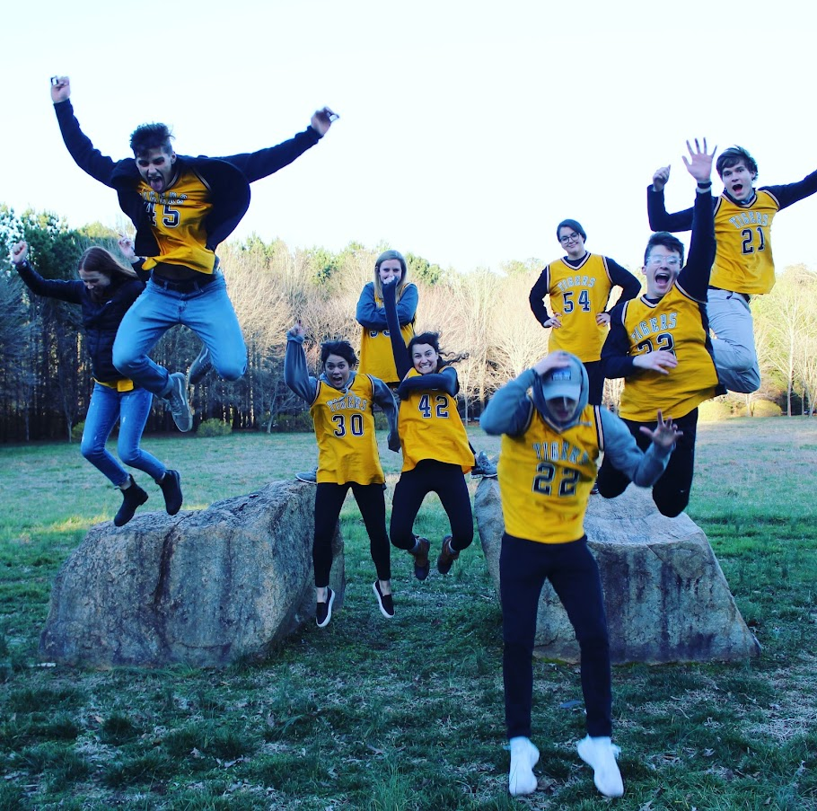
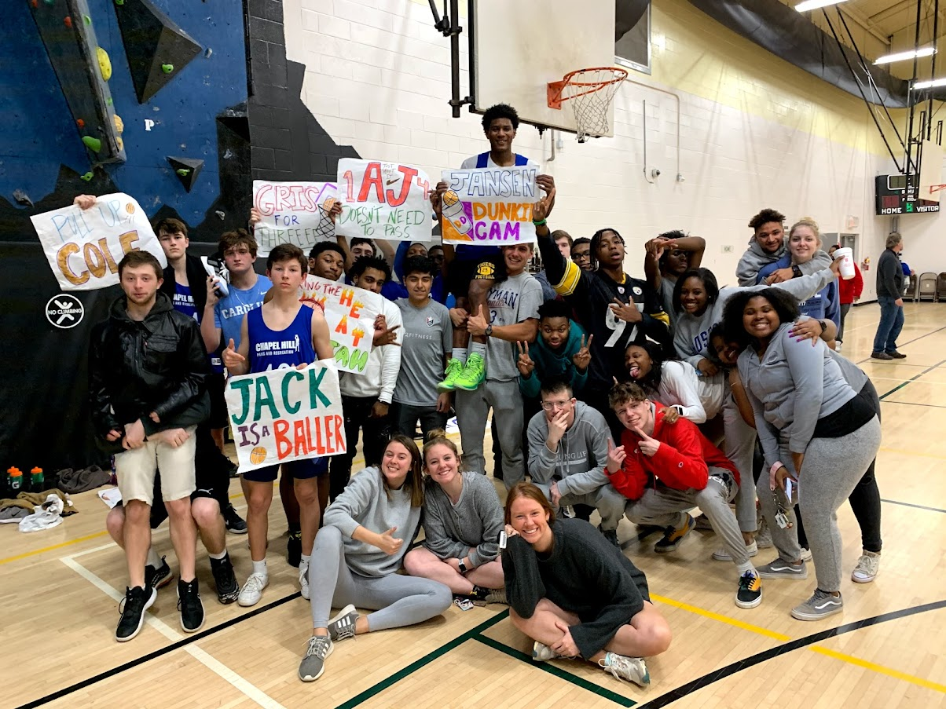
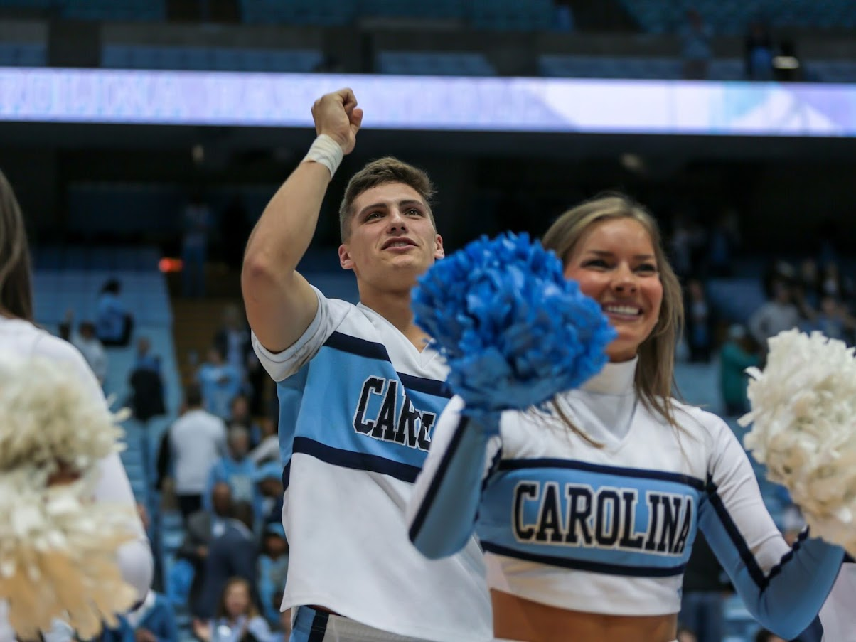
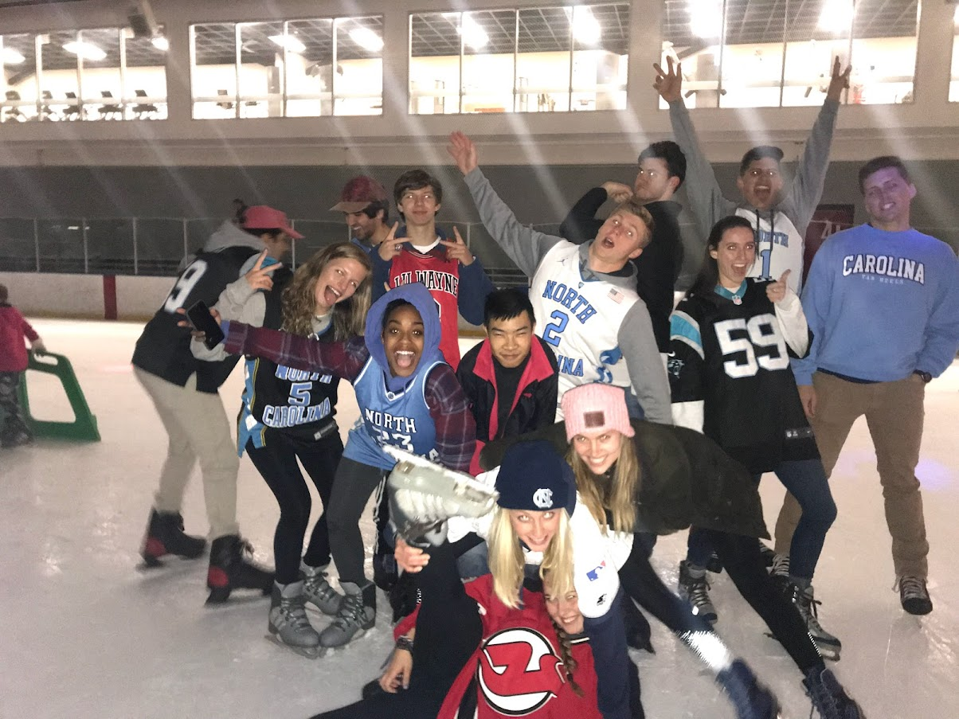
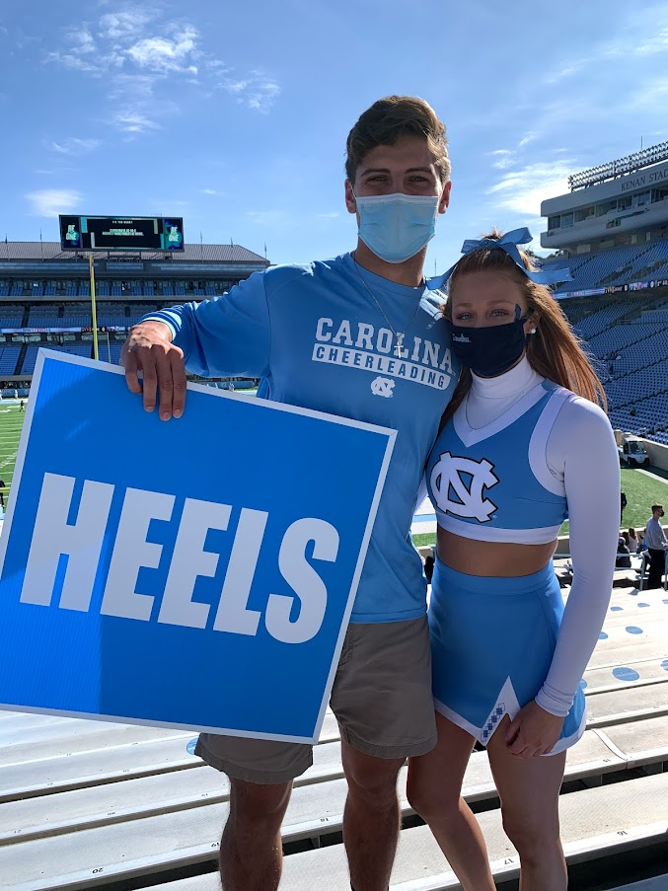
What is School Spirit?

Slide 7
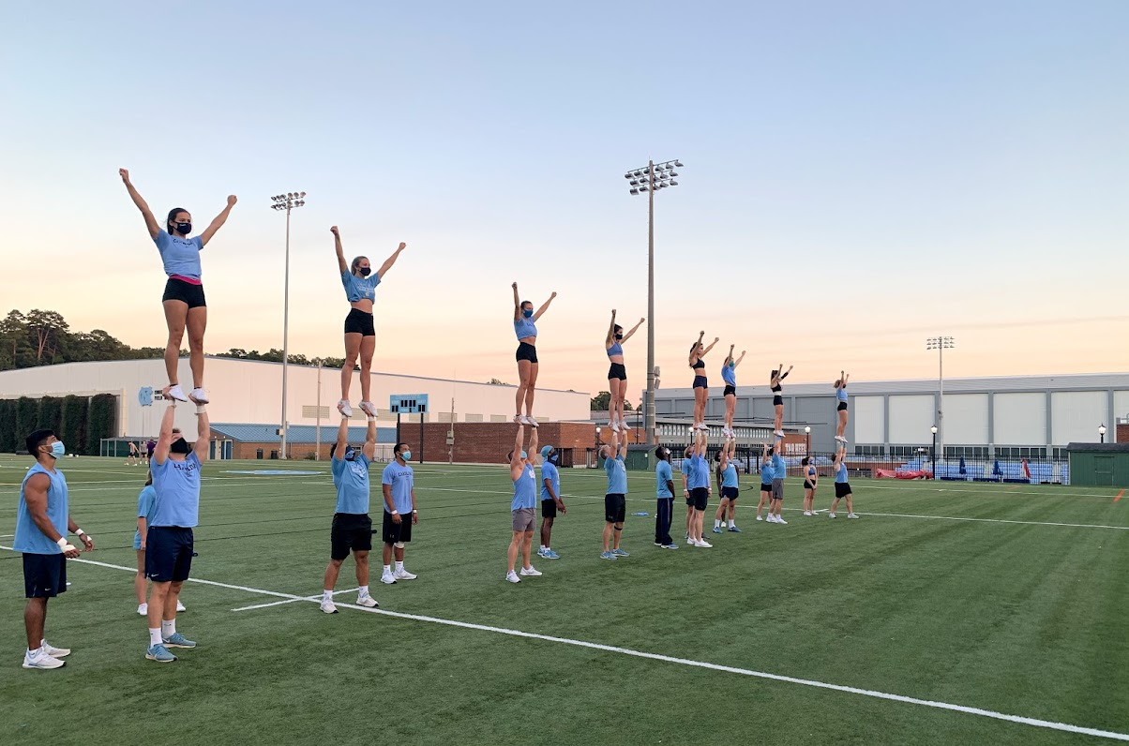
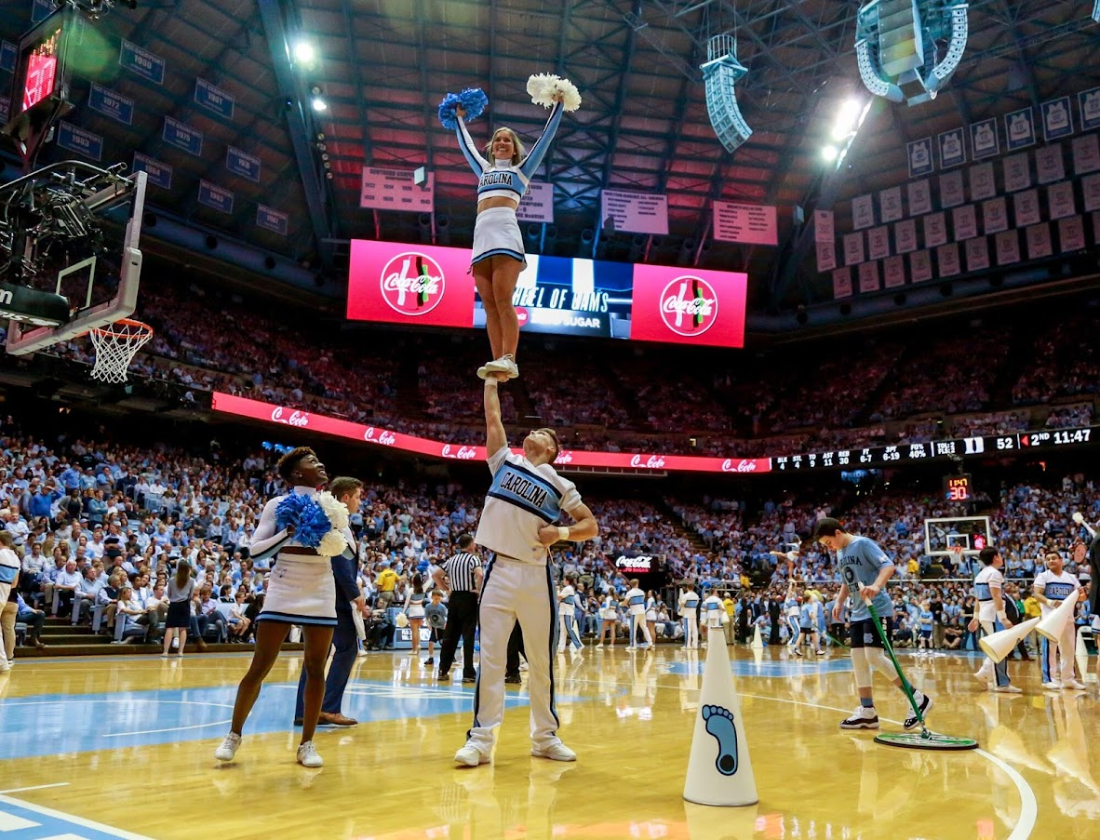
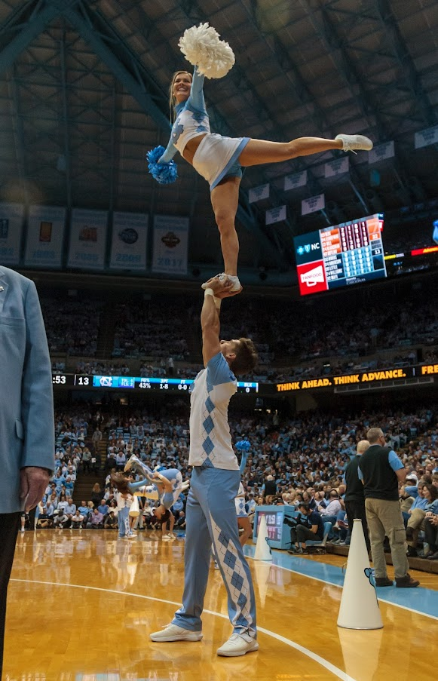
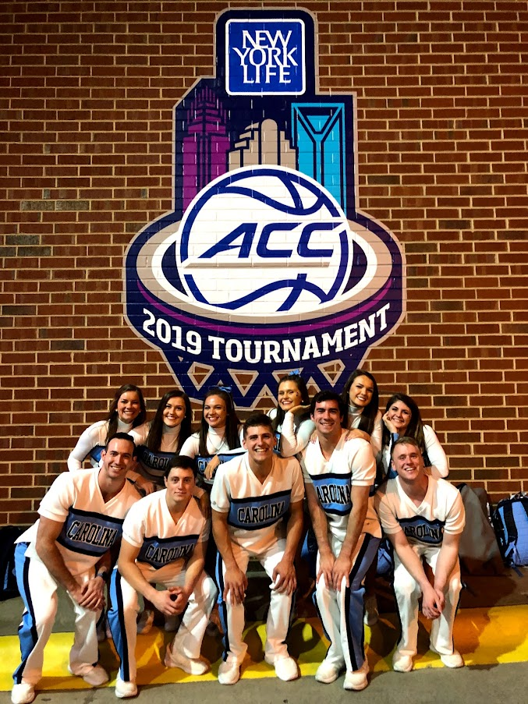
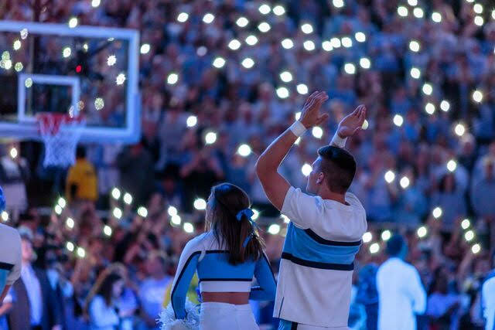

Slide 8
Schedule
7h00 – 8h00 = Field Day Instruction
8h00 – 9h30 = Relay Races
9h30 – 10h00 = Break
10h00 – 11h30 = Matches
11h30 – 12h00 = Awards and Wrap-up

Slide 9
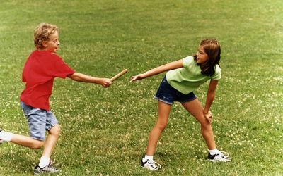
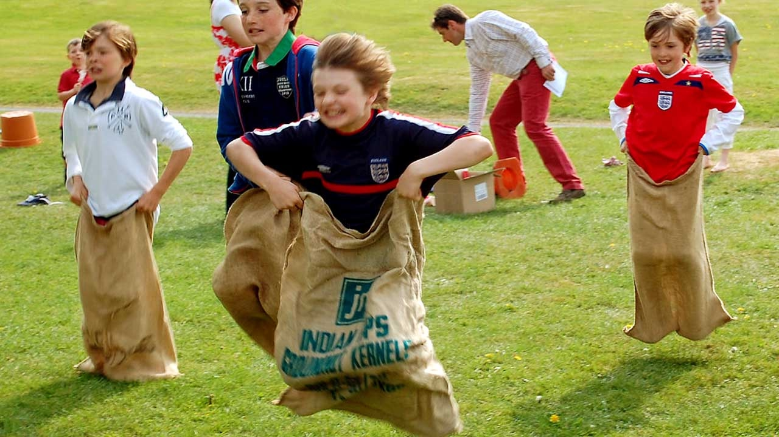
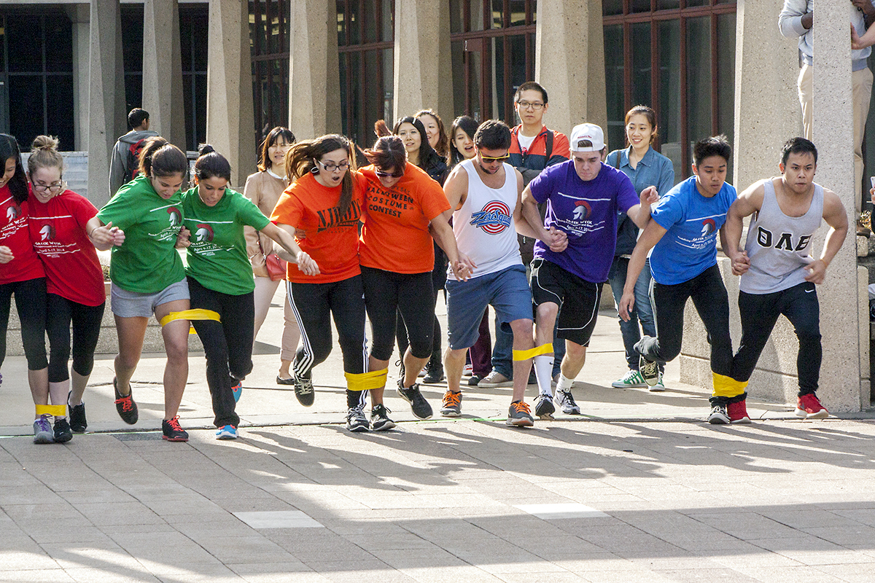
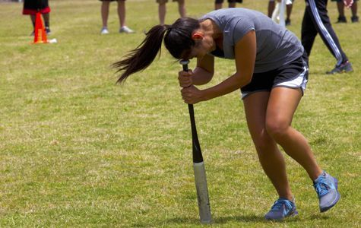
Relay Races
Dizzy Bat
Sack Race
Toilet Paper Over Under
Sponge Bucket Relay
3 Legged Race
Normal Relay Race

Slide 10
Matches
The second half will be full field matches between two teams
Teams will rotate in competitions
There will be Kickball, Football, and Capture the Flag (if time allows)
Teams not participating will be cheering on classmates

Slide 11
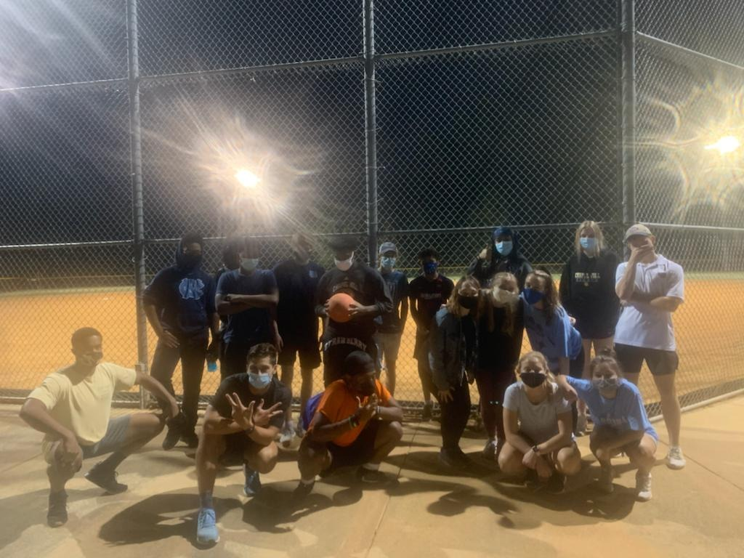
Kickball
This game is played on a baseball field
There are 4 bases
You score points by running all the way around
One team kicks, the other is in the outfield
After 3 outs, the teams switch

Slide 12
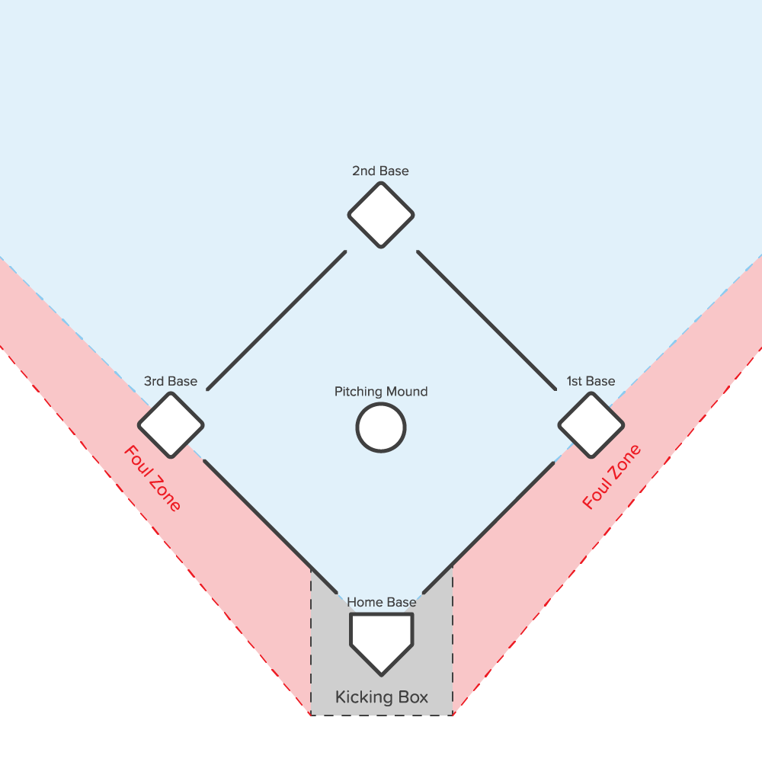
Fair and Foul
A ball outside of the lines is Foul
You get a retry
A ball kicked within the boundaries is Fair
You run the bases
If you catch the ball in the air, the kicker is out

Slide 13
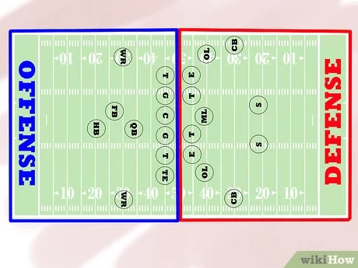
American Football
Quarterback throws the ball
Wide receiver catches the ball
There are 4 plays per 10 yards
After each 10 yards, you get a “first down”
If you catch the ball in the End Zone you score
***NO TACKLING – We play Two Hand Touch

Slide 14
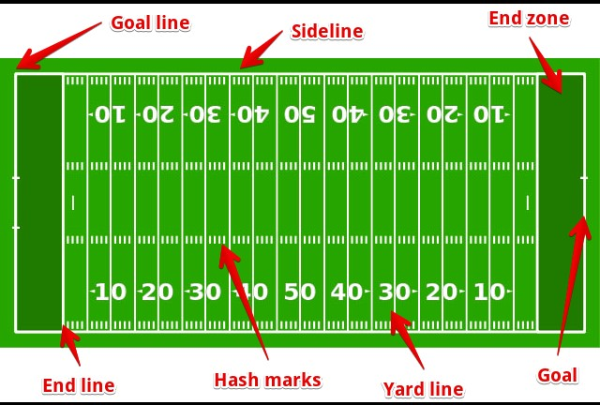
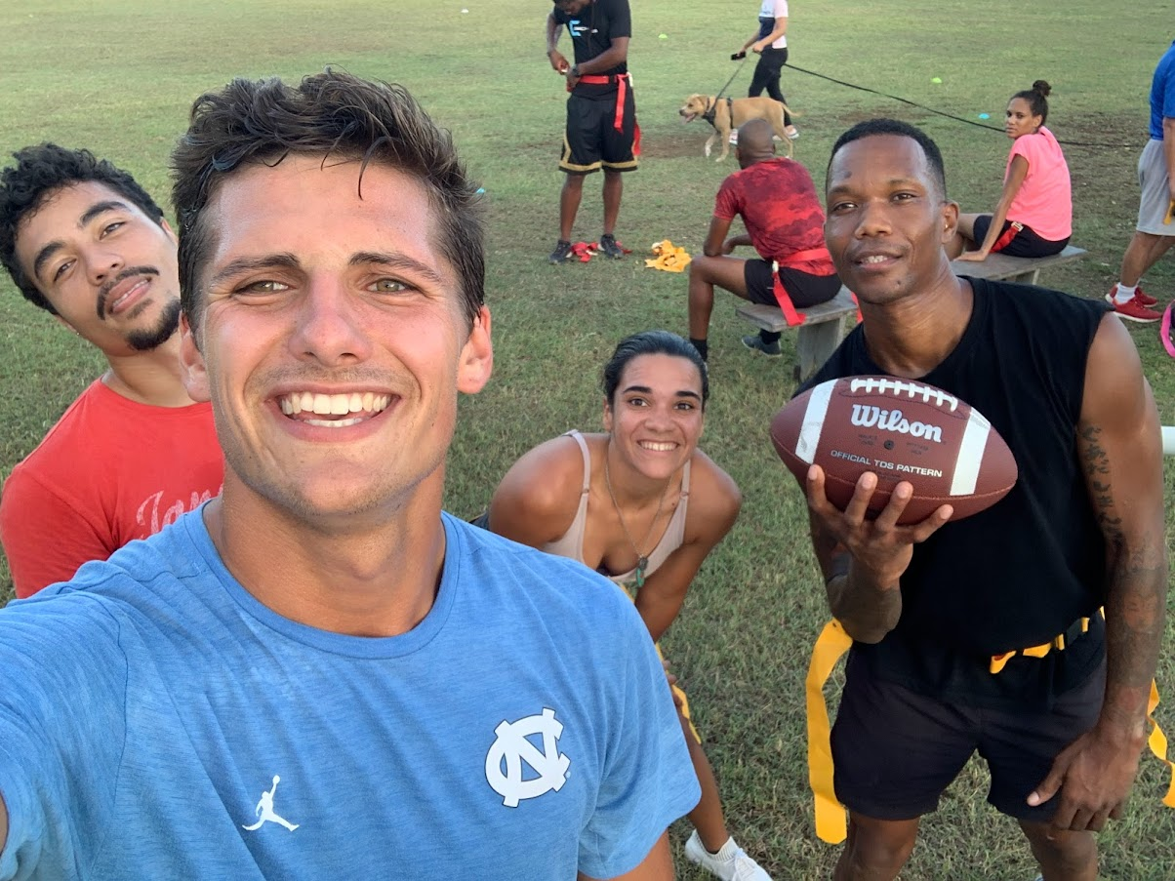
Football Field
1 meter = 1.1 yards
10 Yards per first down
100 yards to the End Zone

Slide 15
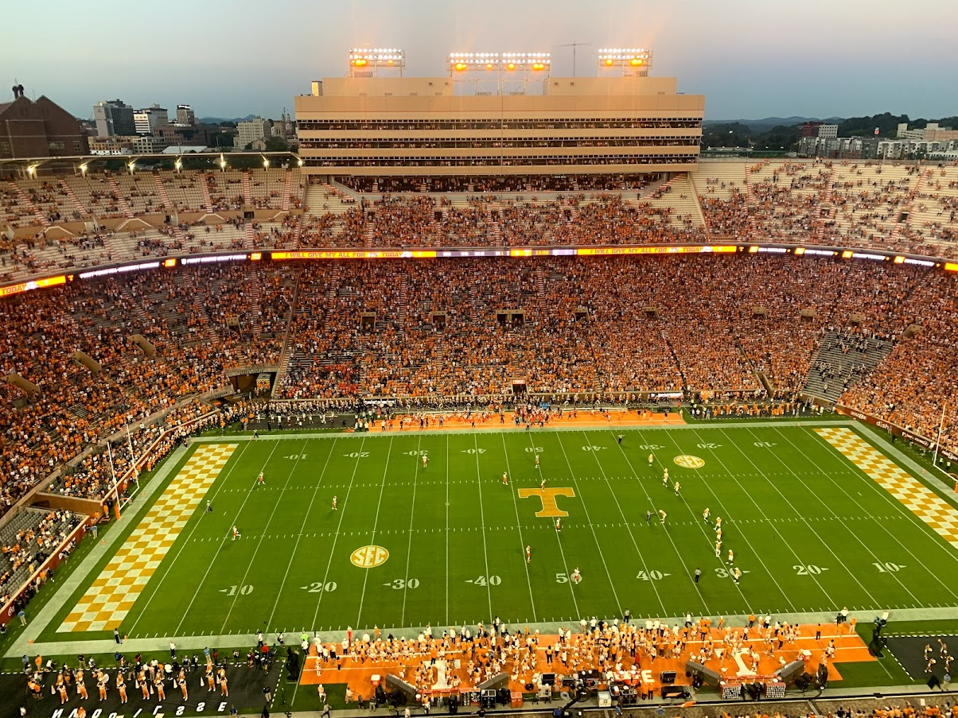
American Football Environment

Slide 16
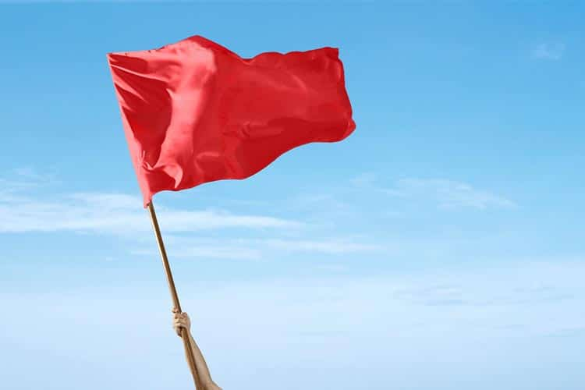
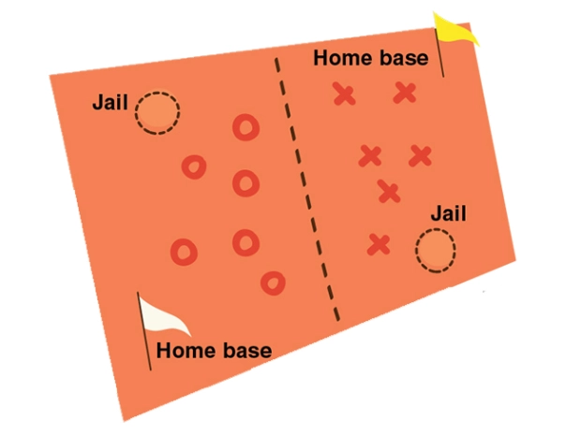
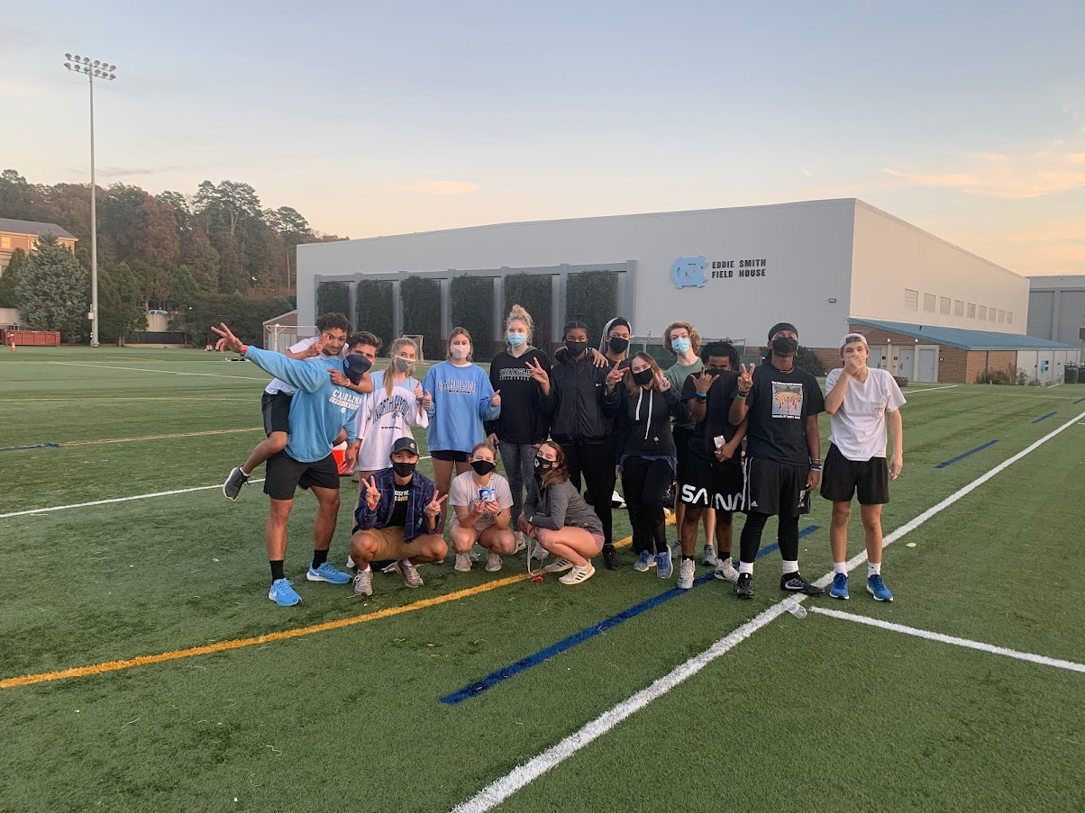
Capture the Flag

Slide 17
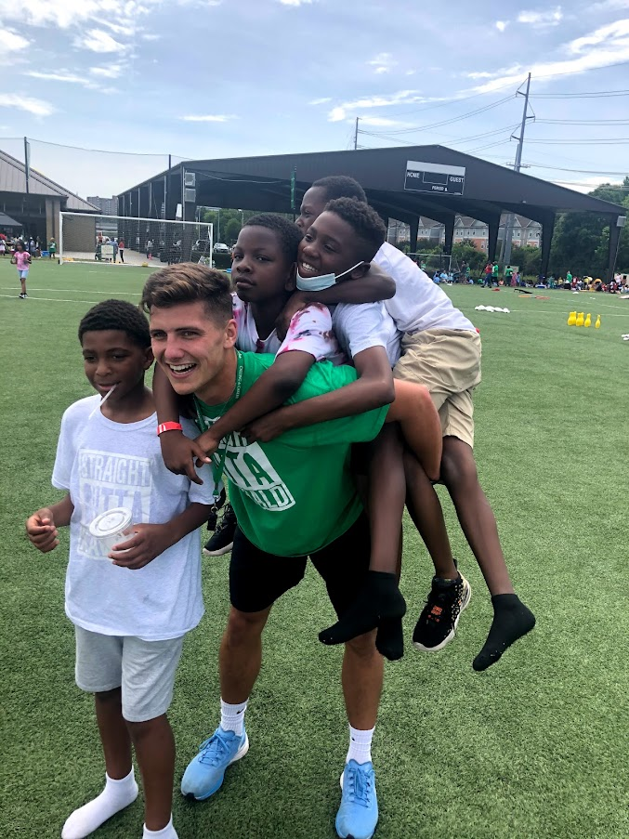
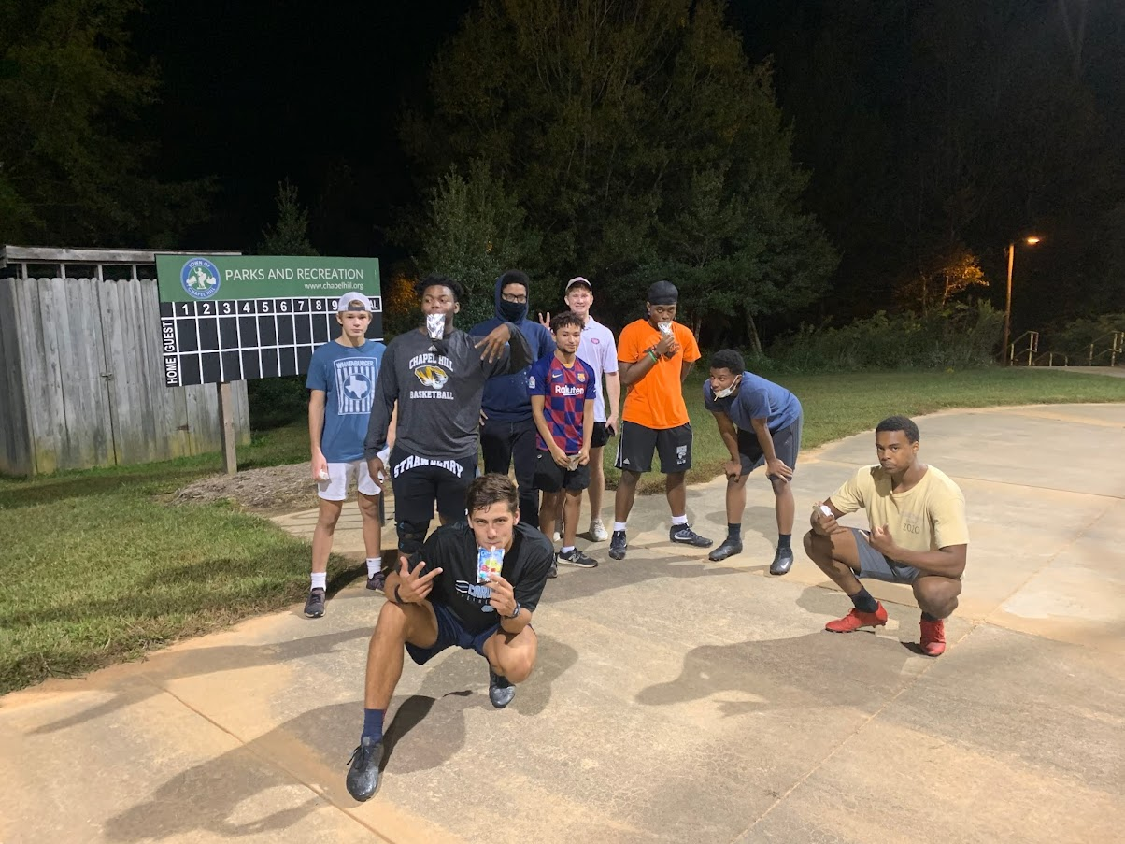
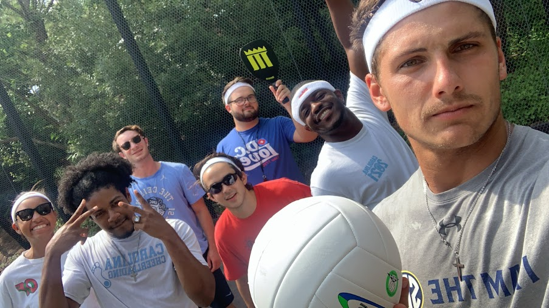
Rules
Listen to the ref
No physical contact
Speak ENGLISH
Have fun!
Cheer for your team!

